Slide 1

Post-Secondary & Scholarship Information

Slide 2
Agenda
Introductions
Choosing a Program
Application
Admission
Financing-Scholarships and Awards

Slide 3
Success Centre Contact Information
Kelly Pretty - kapretty@cbe.ab.ca
Student Services (Blue Community)
Steph Sellar- smsellar@cbe.ab.ca
Student Services (Red Community)
Aly Lefebvre- allefebvre@cbe.ab.ca
Student Services (Orange Community)
Corinne Cadre- clcadre@cbe.ab.ca
Resource Learning Leader

Slide 4
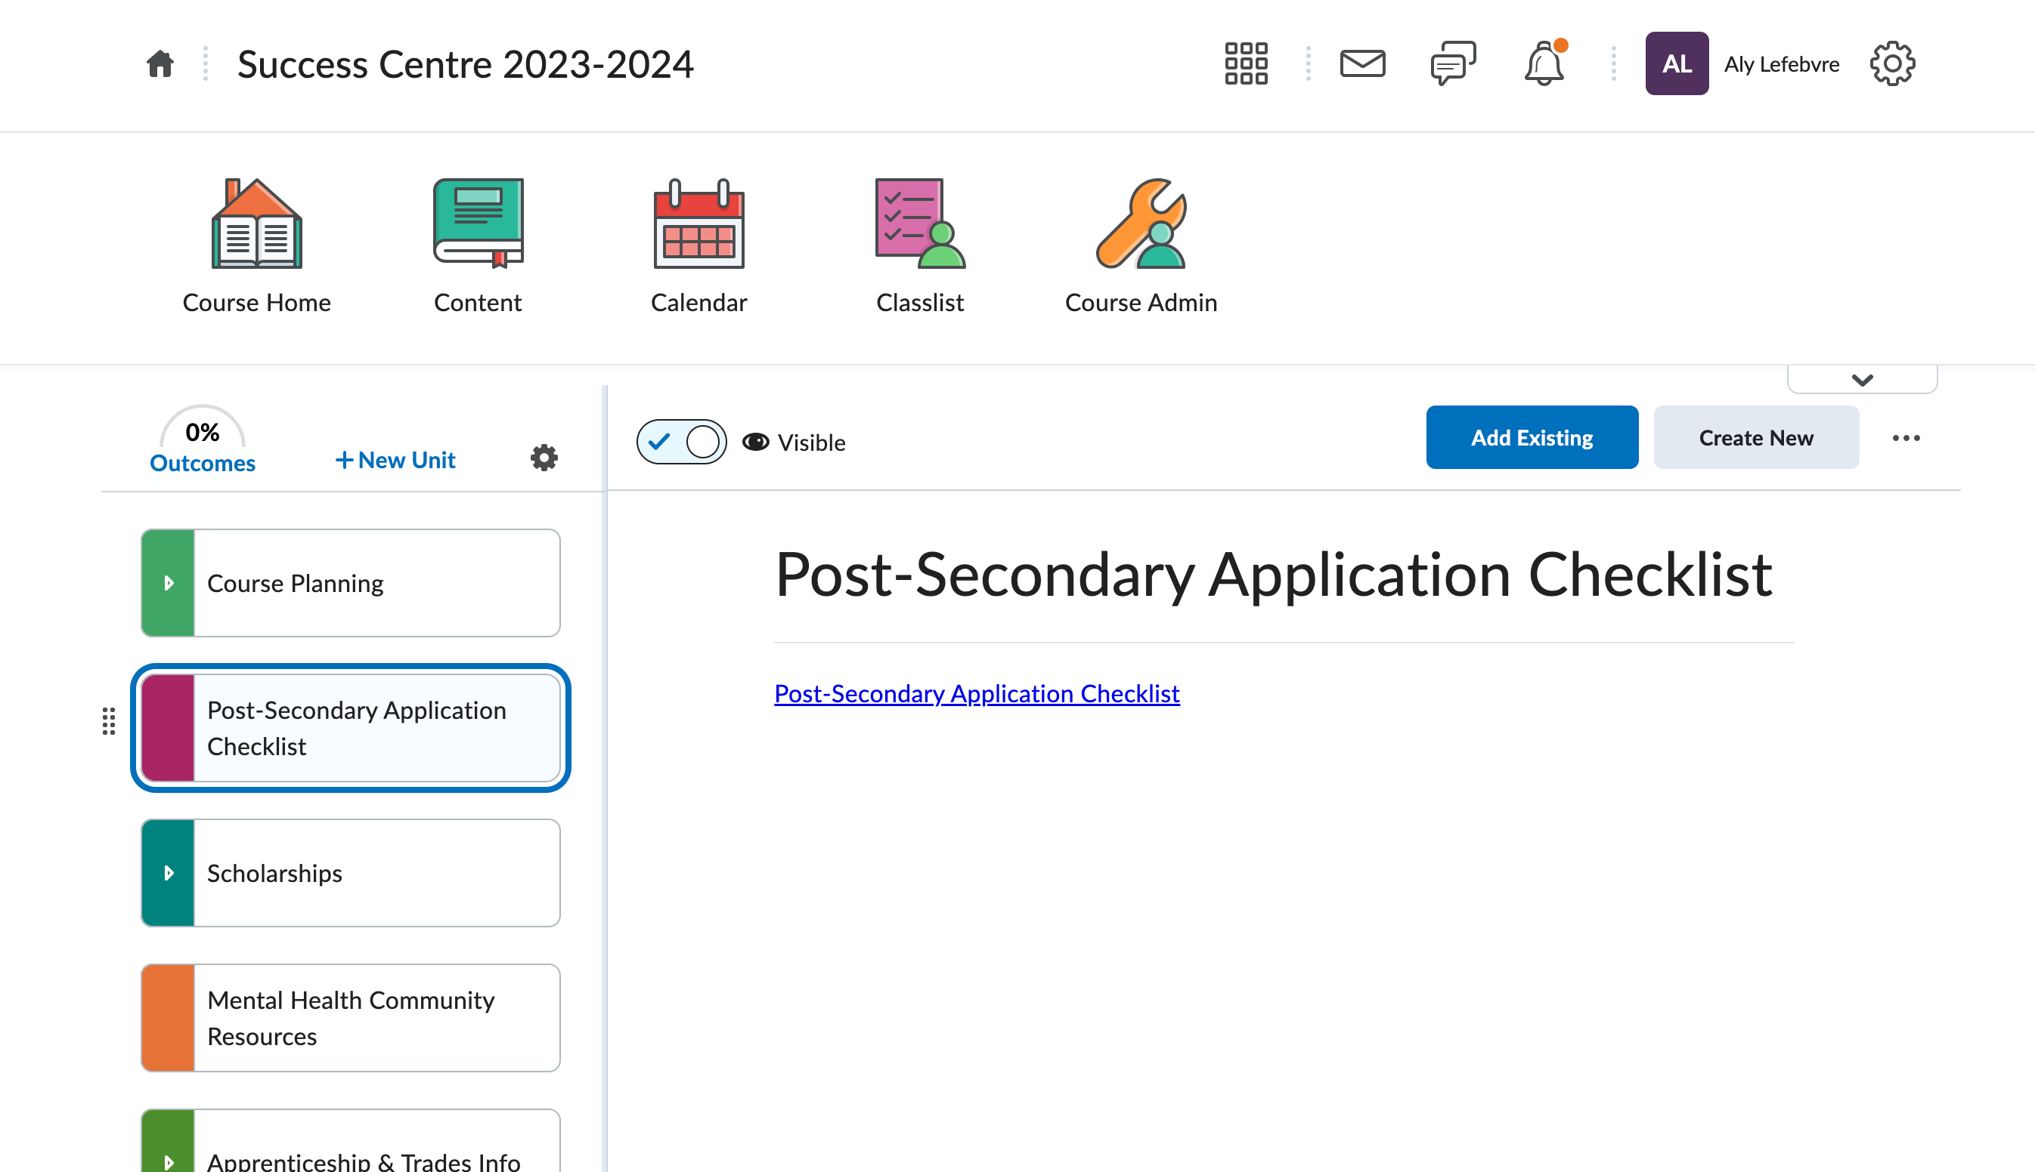
Post-Secondary Application Checklist

Slide 5
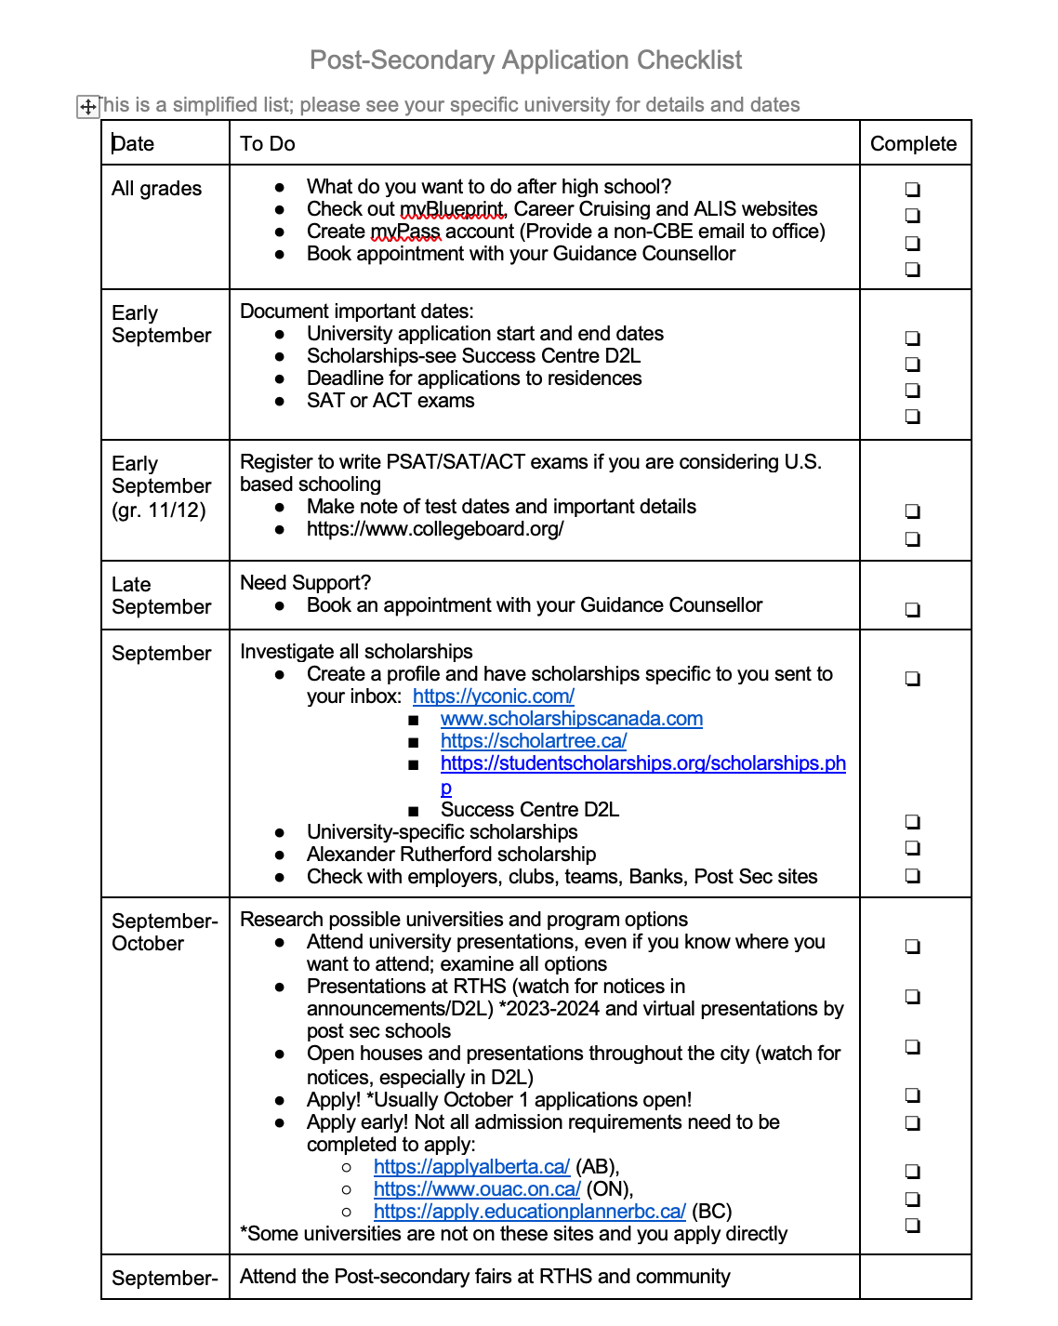

Slide 6
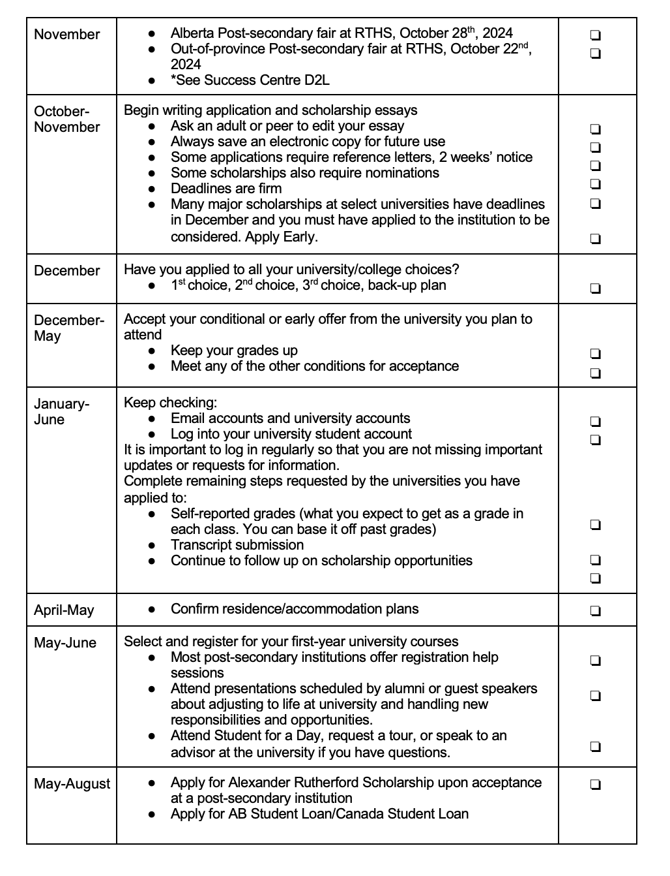

Slide 7







TYPES OF PROGRAMS
University Degree Programs
    Bachelor degree
      typically 4 years
      within a faculty, will declare a major, possibly a minor
      opportunity for dual degrees
      admission based on averages – ensure you are familiar with admission requirements
      If you don't meet admission averages, some schools have university entrance options or general studies
College/Technical Diploma and Certificate Program
    Program lengths differ, usually up to two years
    Many of these programs are first apply first admit
    Ex. Bow Valley, some SAIT programs
    May sometimes have waitlists
    Apprenticeships will have both workplace and classroom components

Slide 8
TYPES OF PROGRAMS
Continuing Education
      Course lengths differ, typically no entrance requirements
      Not always for post-secondary credit but can be useful in building skills for future studies or employment
      --> Personal Fitness Trainer, Strategic Planning (MRU)
      --> Event Technician, Graphic Design Certificate of Achievement (SAIT)
High School Upgrading
--> Chinook Learning Services (In Person) or CBe-Learn (Online)
--> Free until turn 20 years old as of September 1st
--> Post-Secondary Institution Specific, not always transferable

Slide 9
Calgary Post-Secondary Institutions
Colleges
Generally offer 2-year diploma programs and certificates
SAIT
Bow Valley College
Public Universities
Government subsidized tuition; more degree options; generally require a higher competitive average
University of Calgary
Mount Royal University
Alberta University of the Arts
Private Universities
Higher tuition fees; smaller class sizes; fewer degree options; generally lower competitive average
Ambrose University
St. Mary's University

Slide 10
CHOOSING A PROGRAM
This usually happens in one of 2 ways:
A) A student has a particular career or occupation in mind and finds a program to help meet that goal
B) A student knows the general area of study but may not be certain of career
BUT WHAT IF YOU ARE NOT SURE WHAT TO DO OR TO STUDY?

Slide 11



Choosing a Program
Explore Interests and Abilities
--> MyBluePrint (https://www.myblueprint.ca/cbe)
  Use CBE username and password to login
  Complete Who am I surveys on learning styles, personality, interests, knowledge, and motivation
  Afterwards, you can search occupational and post-secondary matches based on your survey results
--> ALIS Career Insite
  Offer surveys and resources to support program and career planning

Slide 12
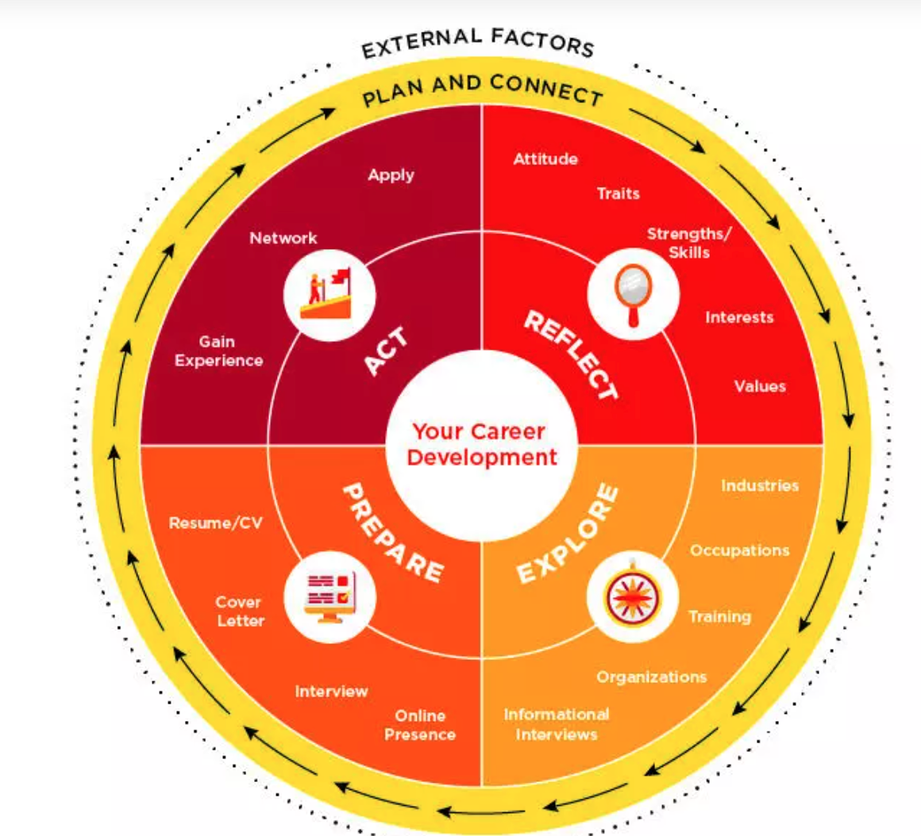
Choosing a Program
University of Calgary
--> Career Wheel Exploration Tool
University of Lethbridge
--> What can I do with my major?

Slide 13
Choosing a Program
Attend Open Houses
Saturday, October 19th
Mount Royal University
Ambrose University
University of Alberta
Saturday, October 26th
University of Calgary
Alberta University of the Arts
Bow Valley College
University of Lethbridge
Friday, October 18th & Saturday, October 19th
SAIT

Slide 14
Choosing a Program
Attend Post-Secondary Fairs at Thirsk
--> Out of Province (OOP) Post-Secondary Fair
Tuesday, October 22nd from 1pm - 3pm
44 Out of Province Post-Secondary Student Recruitment Advisors
--> Alberta-Based Post-Secondary Fair (ELAA)
Monday, October 28th from 9am - 12pm
28 Alberta-Based Post-Secondary Student Recruitment Advisors

Slide 15
COMPARING PROGRAMS
Home or away
Cost
Duration
Transferability
Outcomes (employability, etc.)
Class size
Facilities
Extra-Curricular
Student Satisfaction data
Guaranteed residence

Slide 16
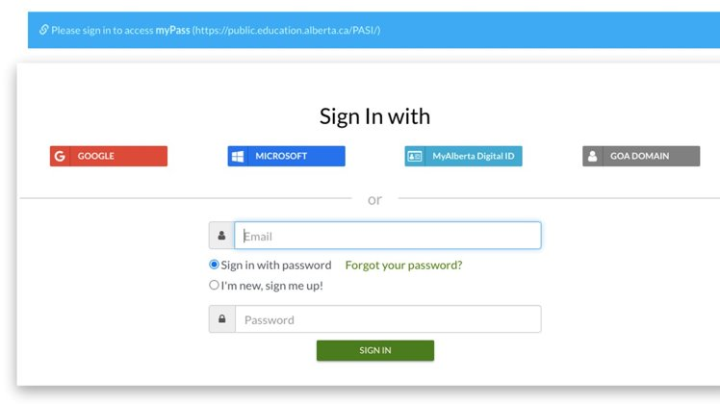
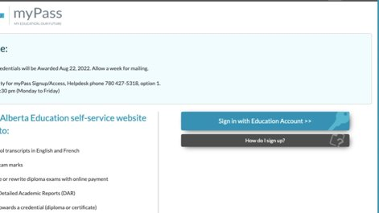
Preparing to apply
Ensure you have created accounts:
MyPass
--> First time Logging in will need Alberta Student Number located on report card in PowerSchool

Slide 17
Preparing to Apply
Application Portals
Apply Alberta
Education Planner (British Columbia)
Ontario Universities' Application Centre
--> All other provinces, students apply directly to the post-secondary school on their website

Slide 18
Preparing to Apply
Have copies of Detailed Academic Reports, Report Cards (obtain from MyPass, PowerSchool)
Ensure you are preparing for supplemental requirements:
- CASPer Test for some Nursing and Education Programs
- Personal Profile (UBC)
- Videos or interviews
BE AWARE OF DEADLINES!

Slide 19
Applying to an Albertan Institution
STEP 1
Create a My Alberta Digital ID
(a basic account is sufficient)
STEP 2
Create an Apply Alberta Account
STEP 3
Apply to Institution through Apply Alberta

Slide 20
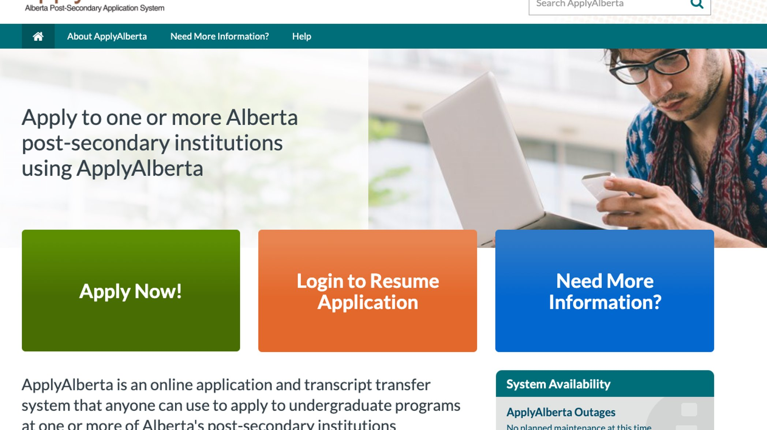

Slide 21
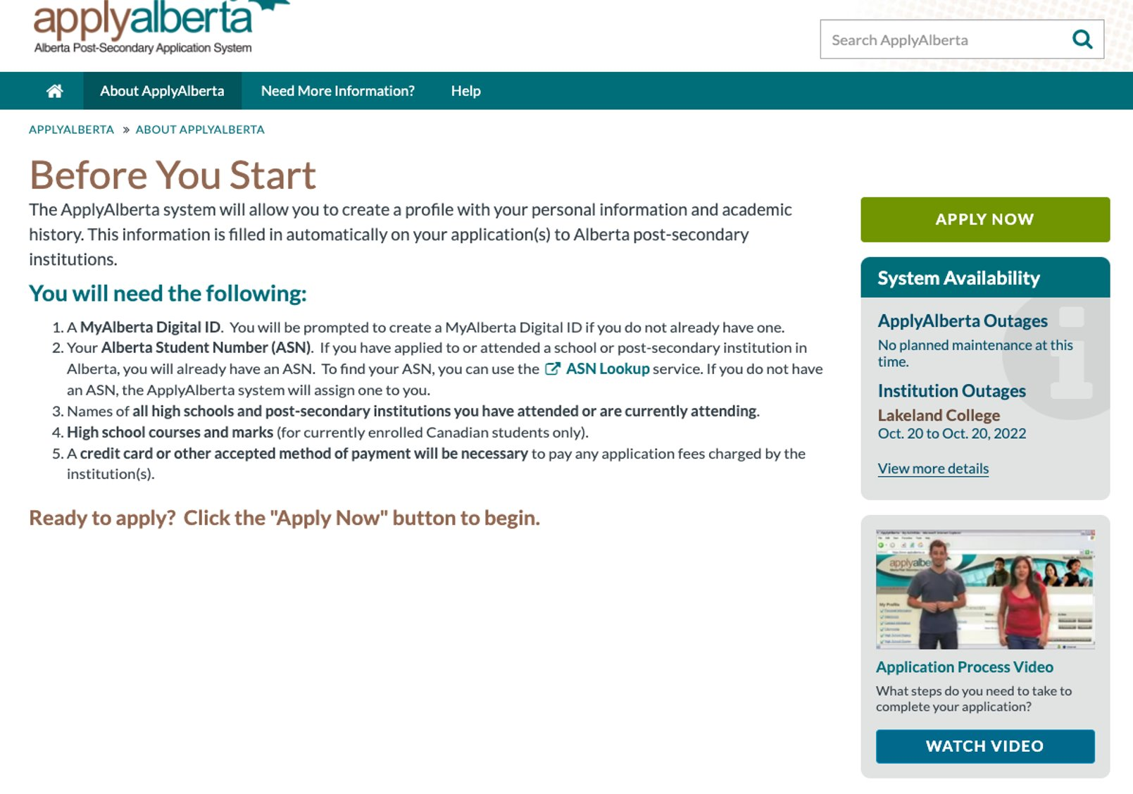


Slide 22
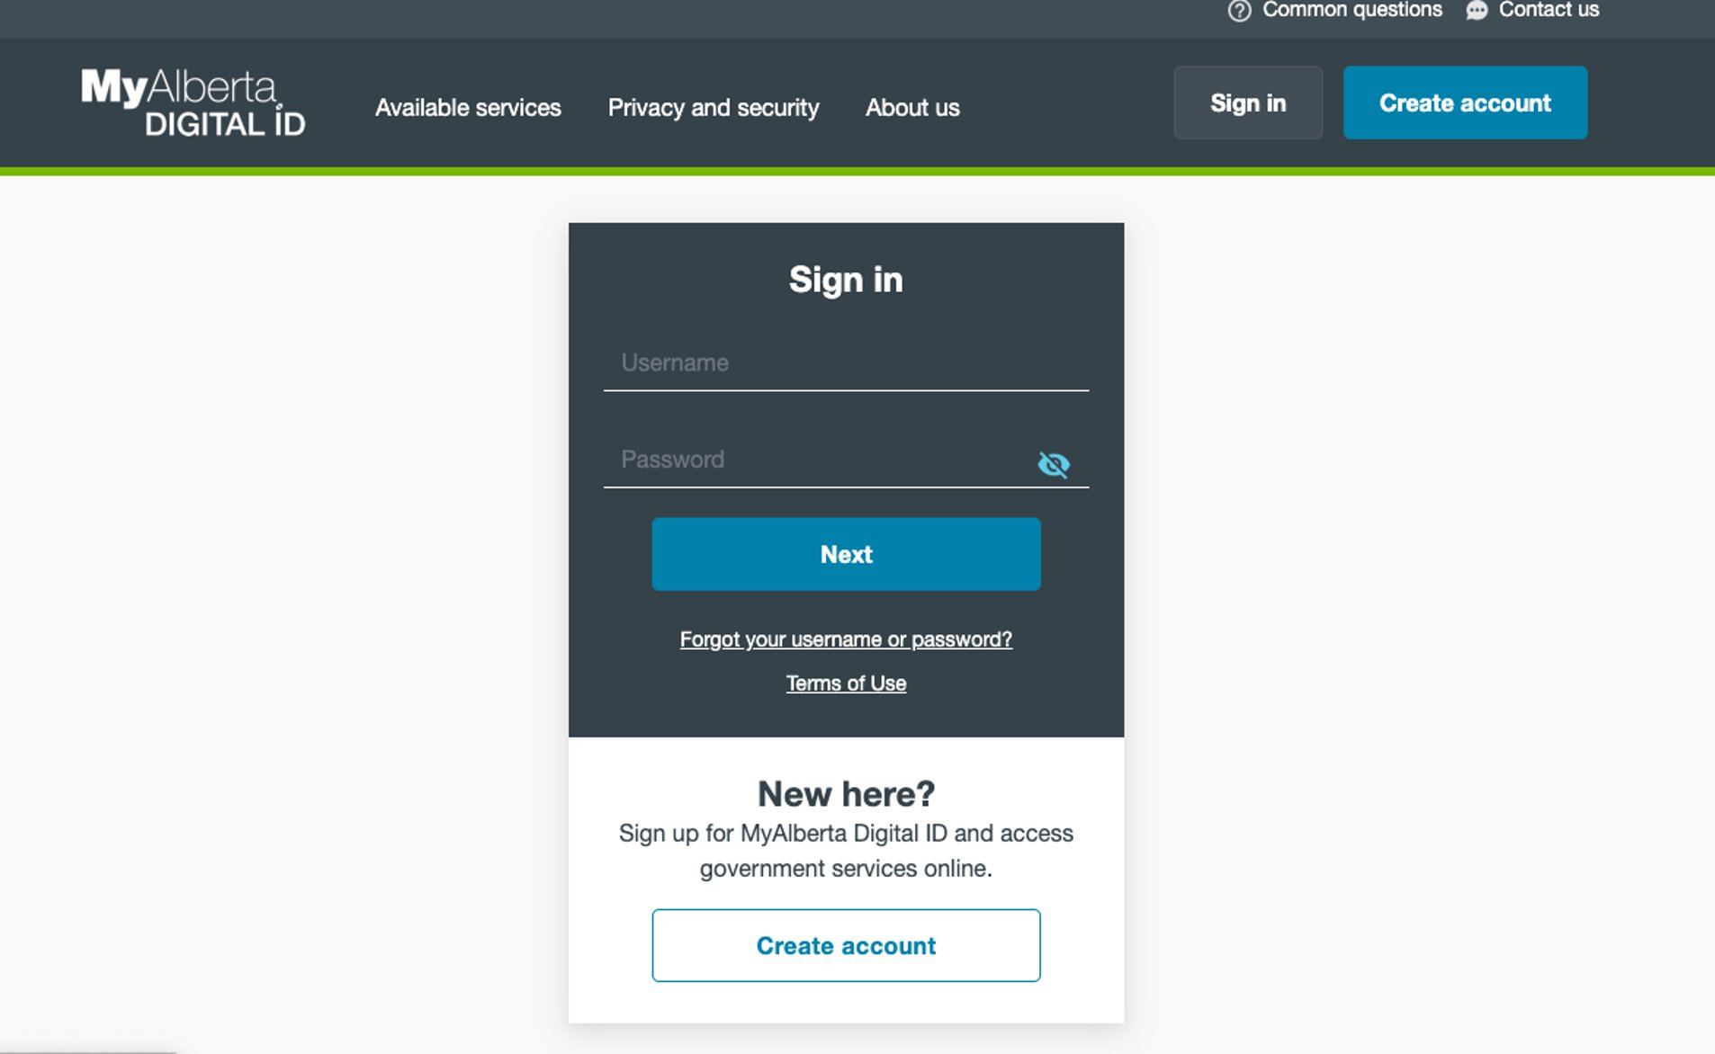

Slide 23
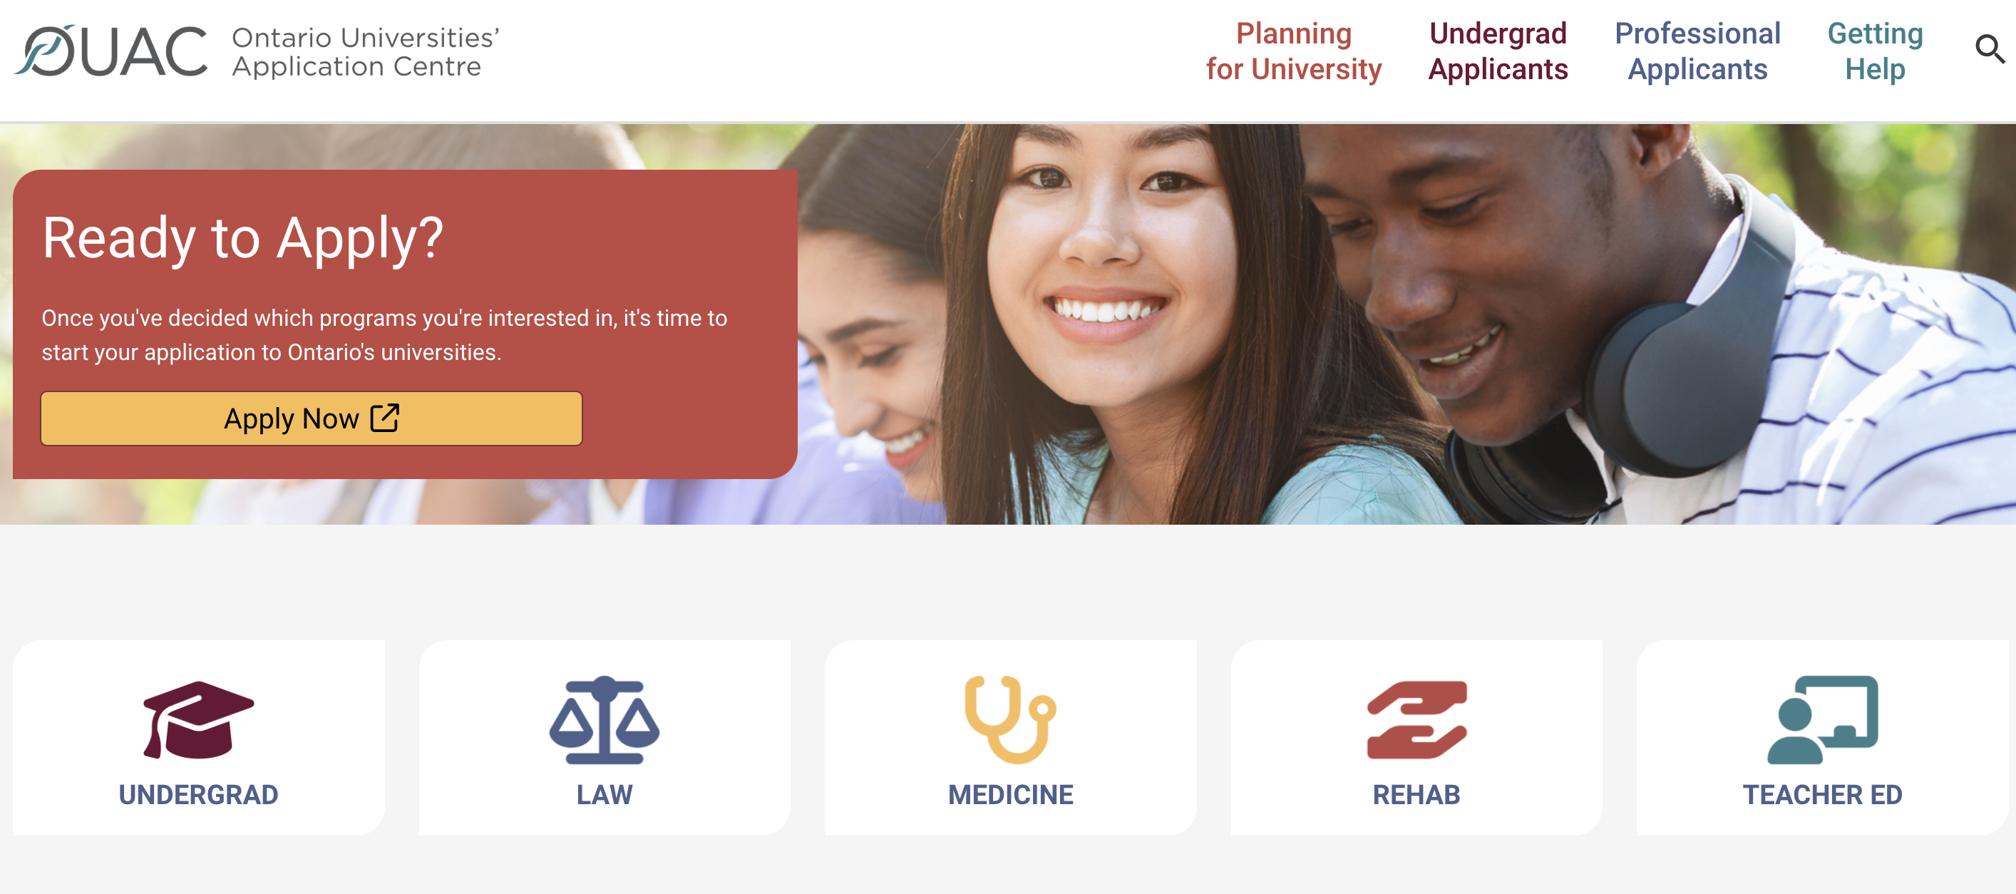

Slide 24
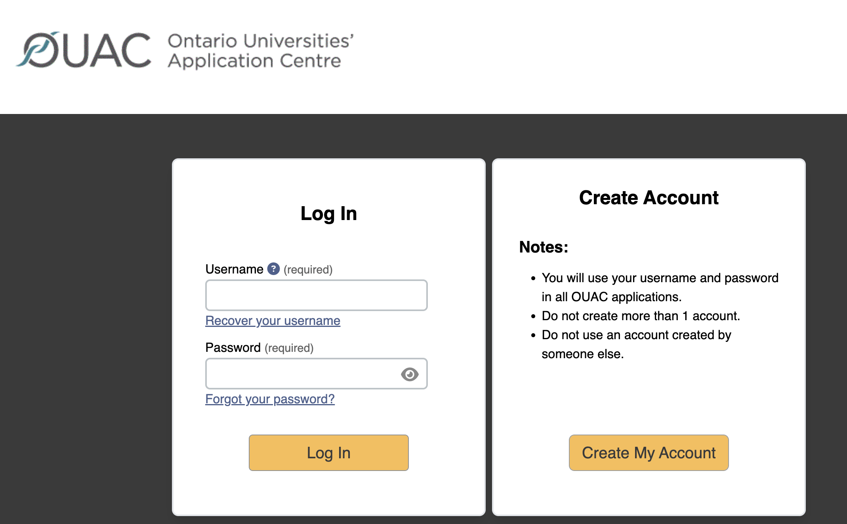

Slide 25
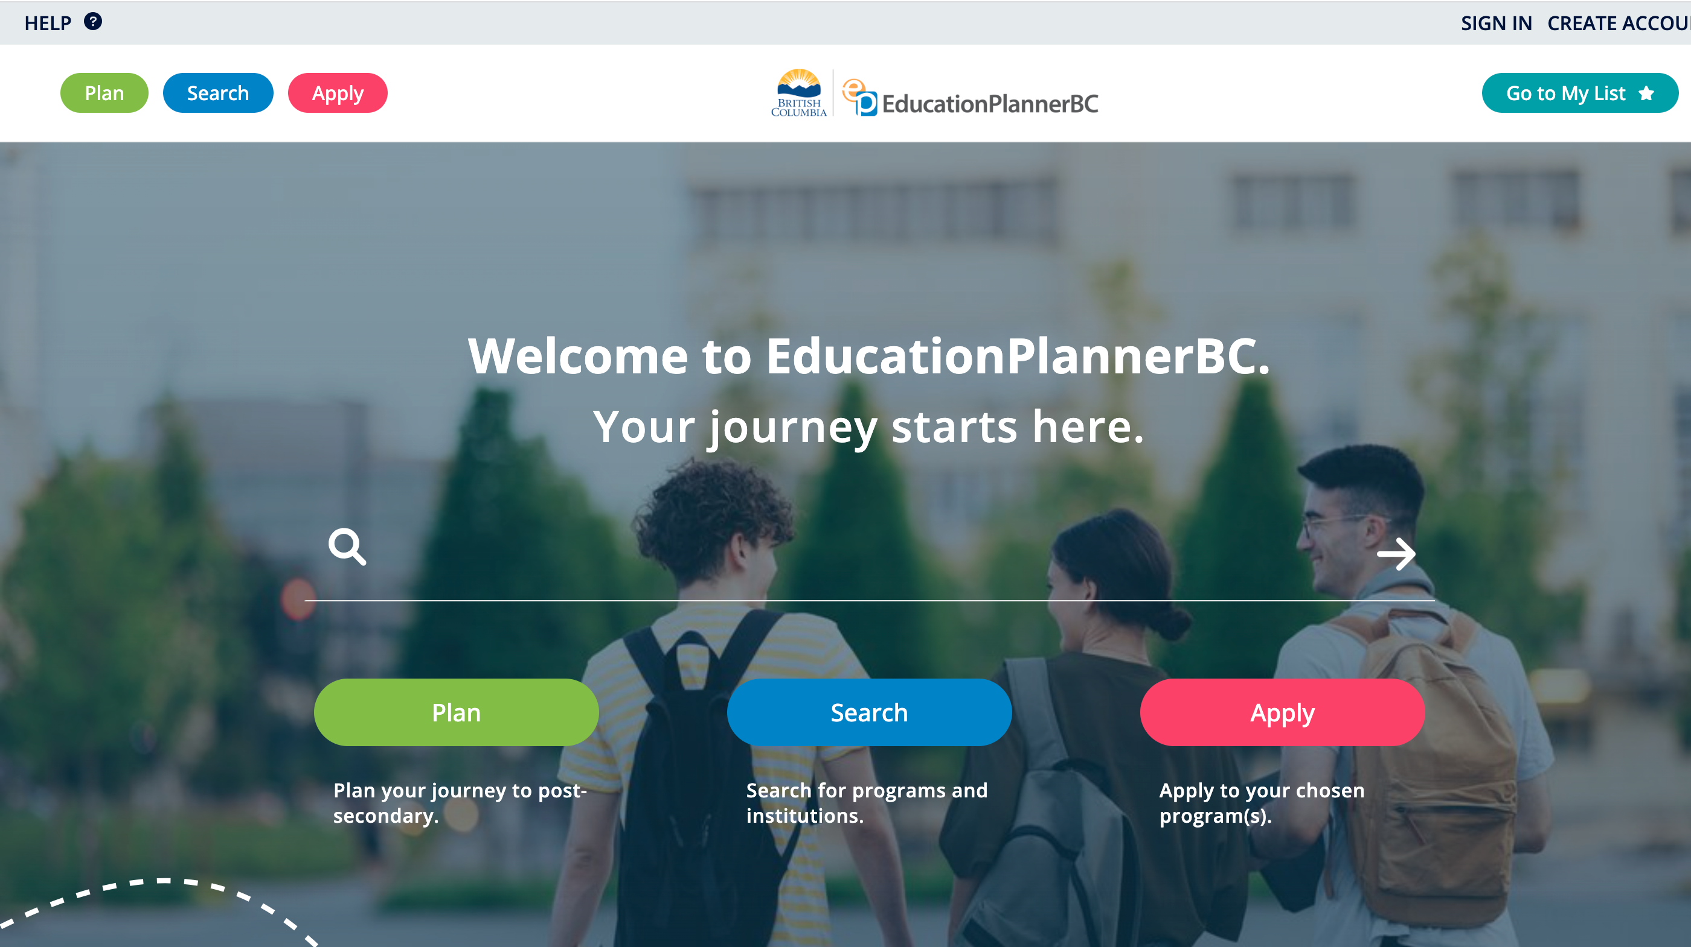

Slide 26
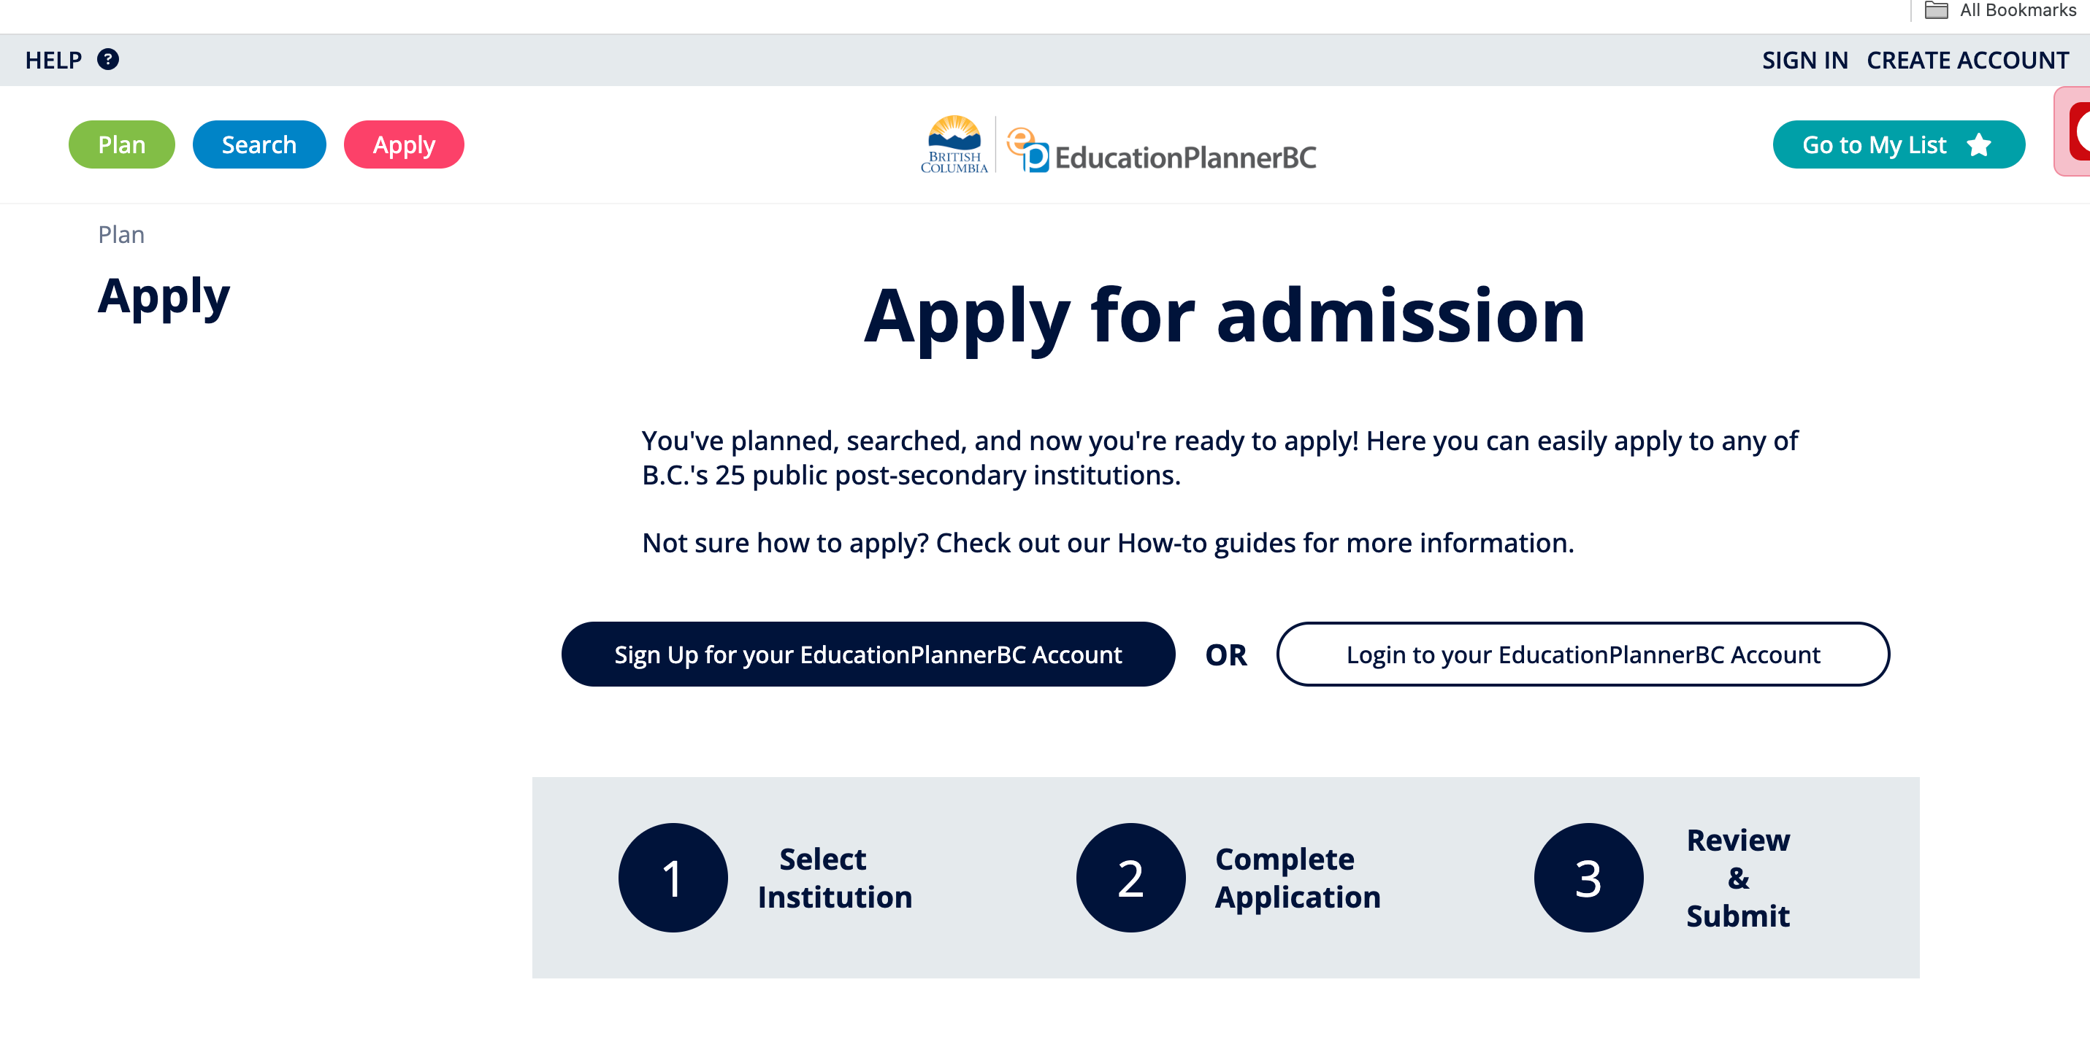

Slide 27
Applying
--> Most post-secondary applications open the beginning of October. Some have firm end dates (March 1st for University of Calgary; January 15th for the University of British Columbia).
--> Applying early is always encouraged as most post-secondary schools operate on a rolling admission policy; if the student does not receive an early offer of admission, their application will automatically roll over to next admission cycle.
--> Most post-secondary institutions allow students to select 2 program choices. Students will only be evaluated for their 2nd choice if they do not receive an offer for their 1st. If they receive an offer for their 2nd choice, they will continue to be evaluated for their 1st.

Slide 28
After Applying
Check your email to ensure that receipt of application is received
Ensure you read the email verification closely and confirm next steps
Apply for entrance awards and scholarships
Apply for residence, if applicable
Mid-February- send an interim transcript if requested
If offered conditional acceptance: accept offer, pay tuition deposit, and register for classes
If attending university outside of Alberta, order final transcript to be sent via MyPass

Slide 29
Transcripts
It is important to pay close attention to what the institution is asking regarding transcripts and course grade submissions as the process is not standardized. U of C will require course grade submission from Apply Alberta. U of A requires course grades are inputted into their Launch Pad Portal. MRU requires students to complete a self-reported grade form and predict the final grades they will receive in grade 12.
University of Calgary and other Alberta-based institutions will automatically request transcripts for students who have attended high school in Alberta.
Students who have applied to a post-secondary school outside of Alberta are required to have a MyPass account initiated to request final transcripts to be sent in July. The process for uploading an initial and interim transcript will vary by institution.

Slide 30
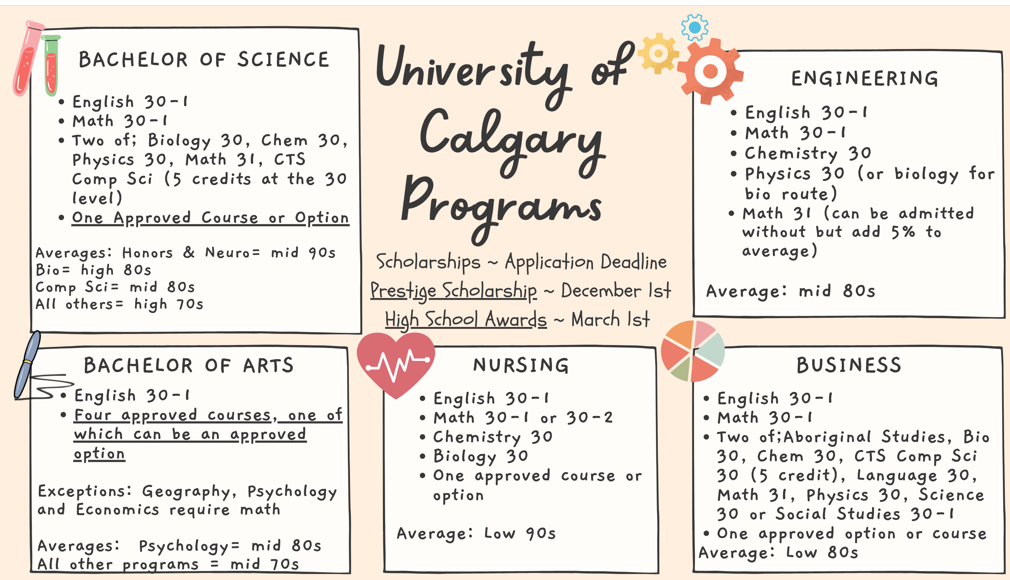
Link to approved options.
Or Science 30

Slide 31
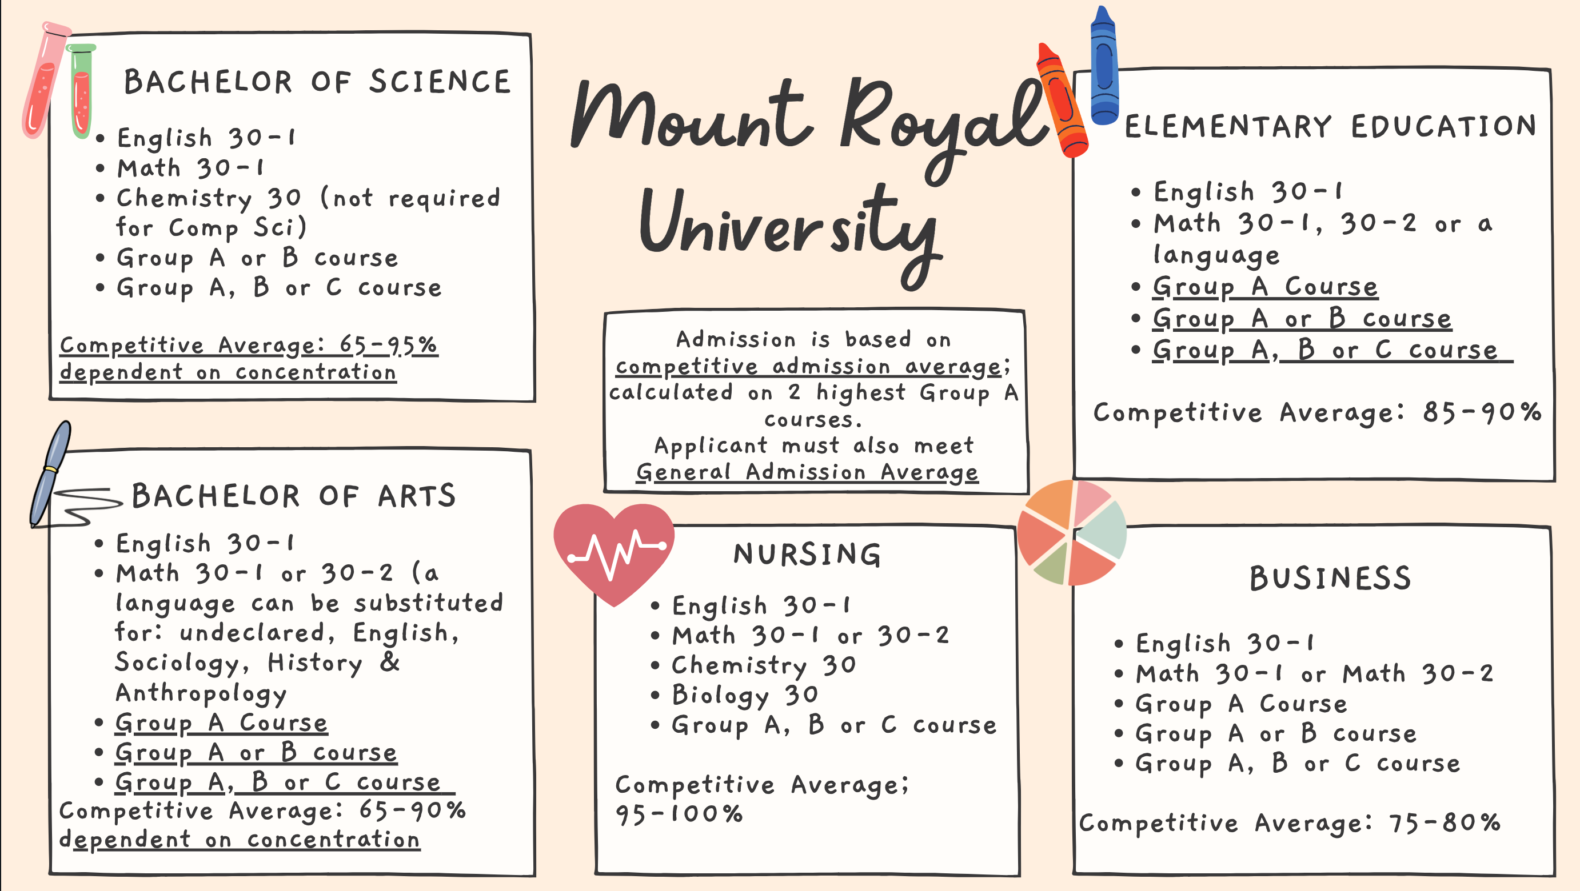

Slide 32
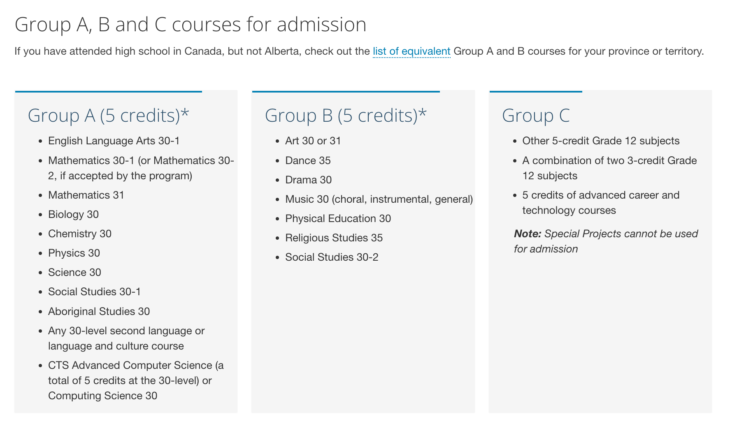

Slide 33
Alternative Routes
Bachelor of Social Work
Mount Royal University
English 30-1
Social 30-1 or Aboriginal Studies 30
3 additional approved 30 level courses
Competitive average: 90-95%
Social Work Diploma
Bow Valley College
English 30-1 or 30-2
*Minimum grade of 65% required in English 30-2
Bow Valley College Transfer Guide

Slide 34
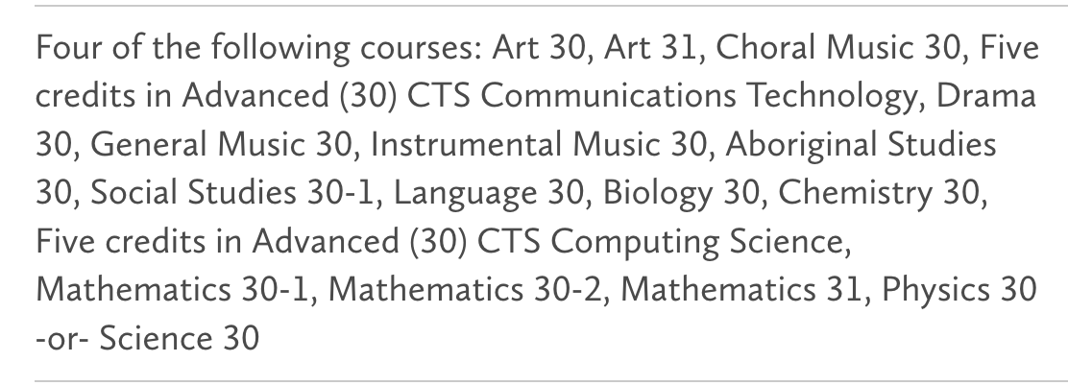
Alternative Routes
Bachelor of Elementary Education
University of Alberta
English 30-1
4 additional 30 level courses
Competitive Average: High 70s to low 80s
Early Childhood Education and Developmental Diploma
Bow Valley College
English 30-1 or English 30-2
*Minimum grade of 65% required in English 30-2
Bow Valley College Transfer Guide

Slide 35
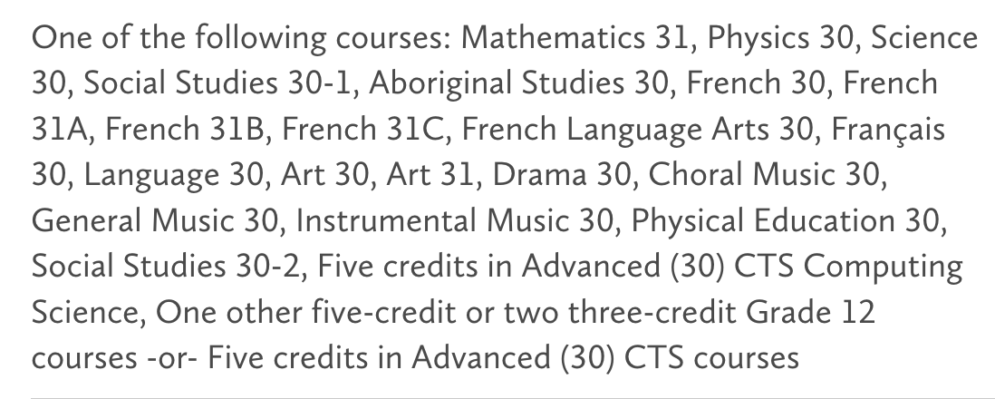
Alternative Routes
Bachelor of Nursing
Mount Royal University
English 30-1
Math 30-1 or Math 30-2
Biology 30
Chemistry 30
1 additional 30 level course:
Competitive Average: 95-100%
Practical Nurse Diploma
Bow Valley College
English 30-1 or 30-2
Math 20-1 or 20-2
Biology 30
*A minimum final grade of 60% is required for English 30-1, Math 20-2, and Biology 30. A minimum grade of 70% in English 30-2
Post LPN Bachelor of Nursing Program with Athabasca University
--> Bow Valley College Transfer Agreement

Slide 36
Applying Outside of Alberta
Ensure you meet academic requirements in grade 11 year. Many universities have different requirements:
--> UBC- Many programs require Physics 20 as an application requirement; recommended to apply with 6- 30 level courses
--> University of Victoria- Apply with 4-30 level approved courses
--> Familiarize yourself with approved options; out of province post-secondary schools may not recognize CTS courses but will fine arts and languages.

Slide 37
LINKS
University of British Columbia
Application Guide
Viewbook
Indigenous Viewbook
Writing a Personal Profile
Scholarships
University of Calgary
Application Guide
Viewbook
Indigenous Viewbook
Competitive Averages
Approved Options
Scholarships
SAIT
Application Guide
Viewbook
Indigenous Supports
Admission Requirements
Scholarships
Mount Royal University
Application Guide
Viewbook
Programs
Indigenous Admissions
Competitive Averages
Scholarships
University of Alberta
Application Guide
Viewbook
Indigenous Guidebook
Competitive Averages
Scholarships

Slide 38

scholarships

Slide 39
Why are Scholarships Important?
Tuition: $4,050 to $8,730
Books and supplies: $1,307 to $1,717
Mandatory fees: $611 to $1,275
Living expenses (living with parents): $2,000 to $4,000
Living expenses (living independently for 8 months): $9,000 to $11,200

Slide 40
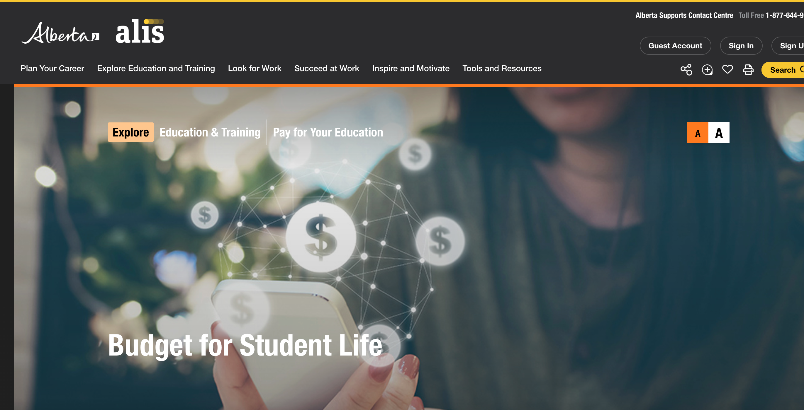
How much will school cost?
Get budget worksheets. Create a Spending Plan. alis.alberta.ca

Slide 41

What Is A Scholarship?
A scholarship is a monetary award which is often based on a variety of criteria:
      Academics
      Volunteer work/Leadership
      Extracurricular activities
      Sports
Financial need may or may not be a factor.

Slide 42
What Is A Bursary?
A bursary is a monetary grant that is usually based on financial need.
The student is in need of financial assistance in order to continue their education

Slide 43
Student Government Loans
Both the Federal and Provincial governments provide student loans for post-secondary study. Students must be Canadian citizens or permanent residents and need to apply through the province that considers them a resident. Government student loans are intended to be supplemental to student and family resources and are awarded based on financial need.
Apply through Student Aid Alberta

Slide 44








Types of Scholarships
Institution-Based Scholarships
Every post-secondary institution will offer first year scholarships for first year students.
Check the institution’s web page for a list of these scholarships.

Slide 45


Institutions Based Entrance Scholarships
Open to students admitted to the post-secondary institute directly from high school.
Students MUST apply to the institute in order to be considered.
Students are considered based on their grade point average from high school. Often they are automatic/no separate application. *Check institution websites!

Slide 46


2. Membership Scholarships
Many organizations have scholarships available to members and their families.
  Example A.T.A. (AB Teachers Association)
  Could include employers, clubs, cultural organizations, religious institutions, or teams.

Slide 47


3. CBE/Local Based Scholarships
Managed by the Calgary Board of Education.
Selected at school or city level.
The typical application time for these is in the spring of the students Grade 12 year. There are a few available for grade 10 and 11 students
--> Education Matters
--> Calgary Foundation

Slide 48




4. Corporate Scholarships
Nationally or provincially selected
    E.g. Toyota, T.D. Bank, Scotia Bank

Slide 49
5. Government Scholarships
Alberta: Alexander Rutherford Scholarship
  75% - 80% and higher average in 5 subjects in grade 10, 11, and 12.
  Different monetary amounts awarded depending on average.
  Value varies from $300 to $2500
  Apply in Gr 12 after being accepted
  Click here for more information

Slide 50
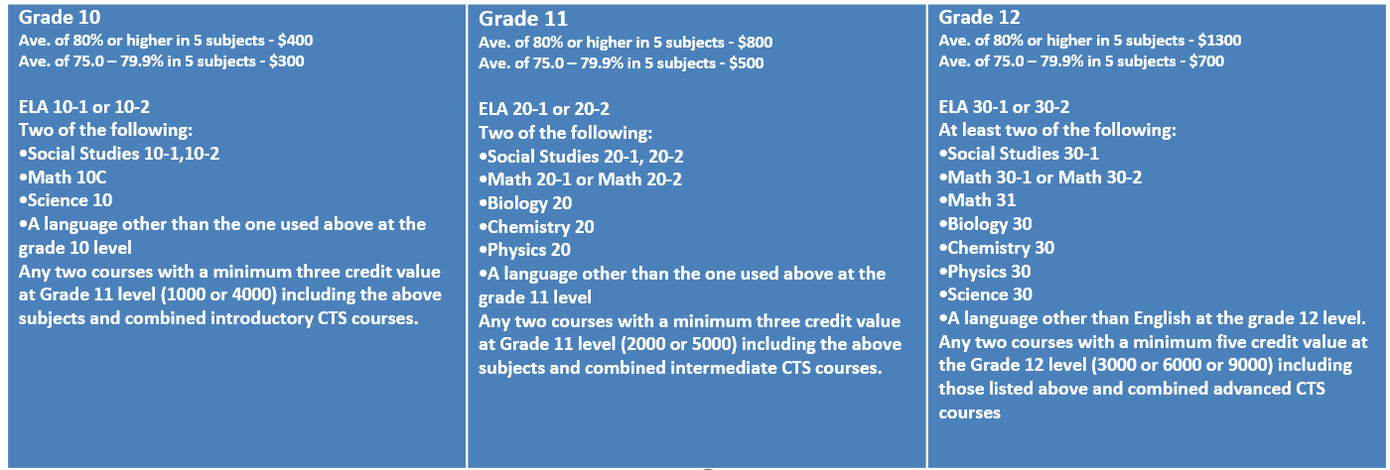
Alexander Rutherford Scholarship

Slide 51
Scholarship Profile
Create a scholarship profile on one of the following sites listed below and you will begin to receive scholarship opportunities to your email that you would be eligible to apply for
--> Yconic
--> Scholarships Canada
--> Scholar Tree
Others
--> Alberta Student Aid Scholarships

Slide 52
Any Questions?

