Slide 1

Post-Secondary & Scholarship Information ​
Optional sidebar title/text/date

Slide 2
Agenda​
Introductions​
Choosing a Program​
Application ​
Admission​
Financing-Scholarships and Awards​

Slide 3
Success Centre Contact Information ​
Kelly Pretty - kapretty@cbe.ab.ca​
Guidance (Blue Community)​
Steph Sellar- smsellar@cbe.ab.ca​
Guidance (Red Community)​
Aly Lefebvre- allefebvre@cbe.ab.ca​
Guidance (Orange Community)​
Aliece Bonnell- ​arbonnell@cbe.ab.ca
Resource Learning Leader​

Slide 4
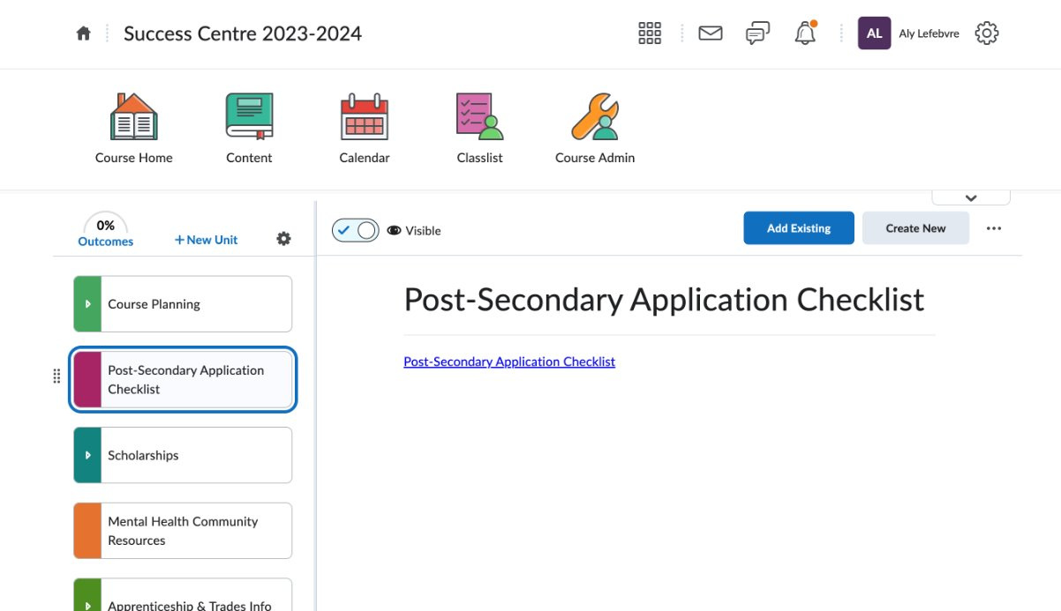
Post-Secondary Application Checklist​

Slide 5
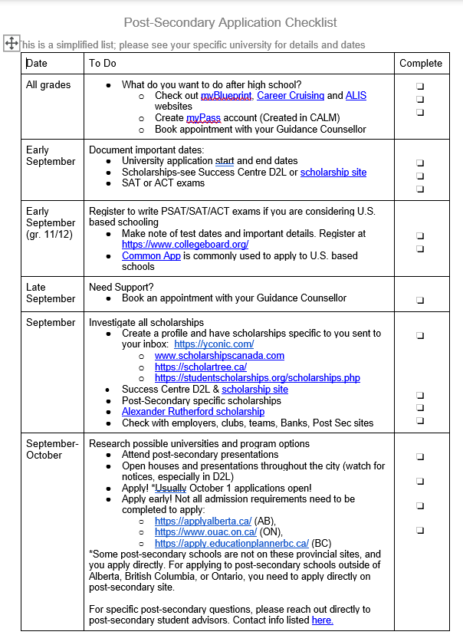
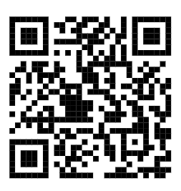
Optional sidebar title/text/date

Slide 6
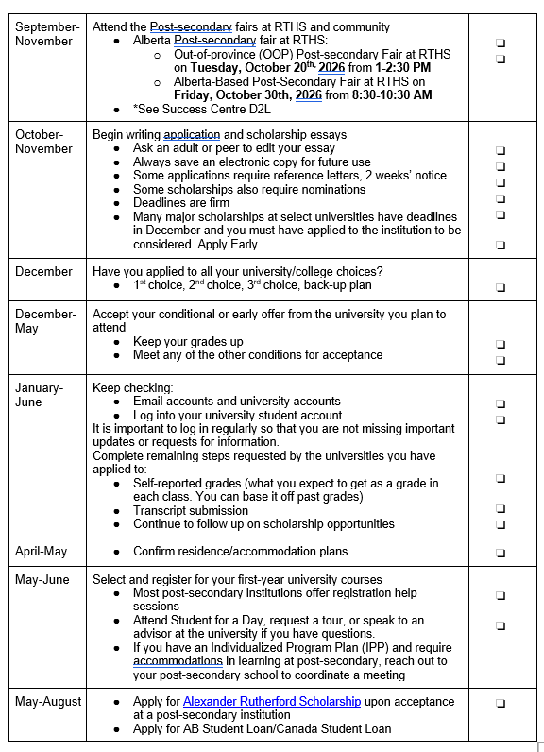

Slide 7
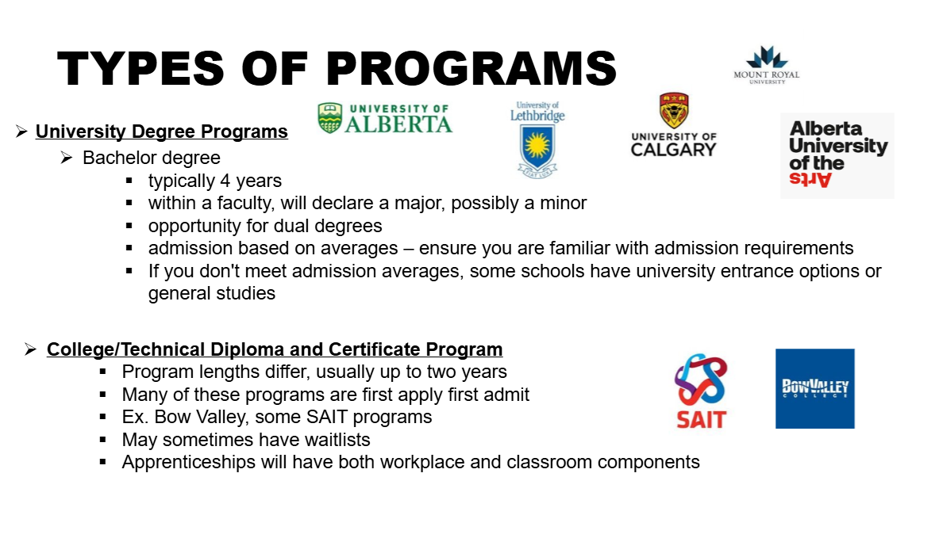
Optional sidebar title/text/date

Slide 8
TYPES OF PROGRAMS​
Continuing Education​
Course lengths differ, typically no entrance requirements ​
Not always for post-secondary credit but can be useful in building skills for future studies or employment​
--> Personal Fitness Trainer, Strategic Planning (MRU)​
--> Event Technician, Graphic Design Certificate of Achievement (SAIT)​
High School Upgrading ​
--> Chinook Learning Services (In Person) or CBe-Learn (Online)​
--> Free until turn 20 years old as of September 1st ​
--> Post-Secondary Institution Specific, not always transferable ​

Slide 9
Calgary Post-Secondary Institutions​
Colleges​
Generally, offer 2-year diploma programs and certificates​
​
SAIT​
Bow Valley College​
Public Universities​
​
Government subsidized tuition; more degree options; generally, require a higher competitive average​
​
University of Calgary​
Mount Royal University​
Alberta University of the Arts​
Private Universities​
​
Higher tuition fees; smaller class sizes; fewer degree options; generally lower competitive average​
​
​
Ambrose University​
St. Mary's University​

Slide 10
CHOOSING A PROGRAM​
This usually happens in one of 2 ways:​
A) A student has a particular career or occupation
in mind and finds a program to help meet that goal​
​
B) A student knows the general area of study but may not
be certain of career​
​
BUT WHAT IF YOU ARE NOT SURE WHAT TO DO OR TO STUDY?​

Slide 11


Choosing a Program​
Explore Interests and Abilities ​
--> MyBluePrint (https://www.myblueprint.ca/cbe)​
Use CBE username and password to login ​
Complete Who am I surveys on learning styles, personality, interests, knowledge, and motivation ​
Afterwards, you can search occupational and post-secondary matches based on your survey results
--> ALIS Career Insite ​
Offer surveys and resources to support program and career planning

Slide 12
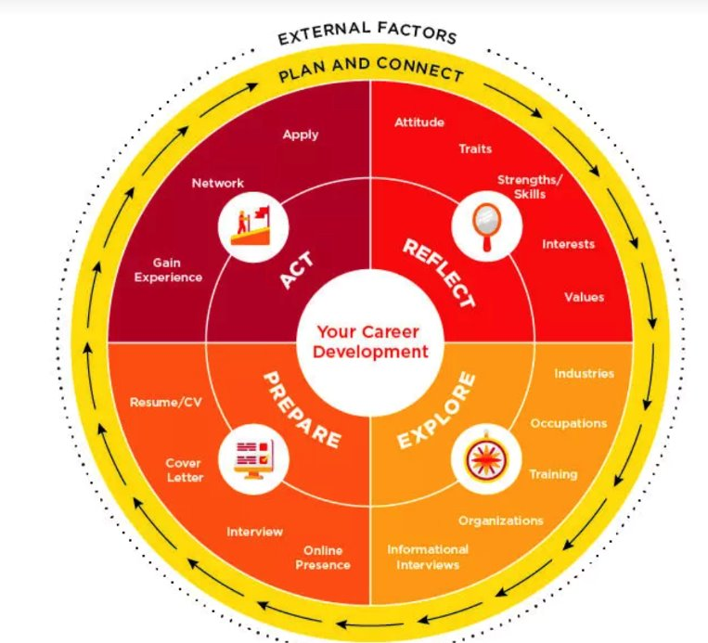
Choosing a Program​
University of Calgary​
--> Career Wheel Exploration Tool​
University of Lethbridge​
--> What can I do with my major?​

Slide 13
Choosing a Program​
Attend Open Houses​
AU Arts
(October 24th)
Ambrose University
(October 24^{th)}
University of Alberta
(October 17th)
Bow Valley College
(October 3rd)
University of Calgary
(October 24th)
Mount Royal University
(October 17th)
Old's College
(October 2nd & 3^{rd)}
SAIT
(October 23rd & 24th)
St. Mary's University
(November 7th)
University of Lethbridge
(October 24th)

Slide 14
Choosing a Program​
Attend Post-Secondary Fairs at Thirsk​
--> Out of Province (OOP) Post-Secondary Fair ​
Tuesday, October 20th from 1pm – 2:30 PM
40-50 Out of Province Post-Secondary Student Recruitment Advisors​
​
--> Alberta-Based Post-Secondary Fair (ELAA)​
Friday, October 30th from 8:30 AM-10:30 AM
20-30 Alberta-Based Post-Secondary Student Recruitment Advisors​

Slide 15
Choosing a Program
Attend Post-Secondary Booths and Presentations @ RTHS
University of Calgary- September 9th; Presentation @ lunchtime in Theatre
McMaster University: September 14th Booth in the Space @ 2:45 PM​
University of Victoria: September 15th Booth in the Space @ 8 AM​
Mount Royal University: September 16th Presentation in Theatre @ lunchtime​
St. Mary's University: September 17th Booth in the Space @ 8 AM​
SAIT: September 17th Presentation in Room 212 @ lunch
University of Arizona: October 1st Booth in the Space @ 8 AM
University of Calgary: October 6th Booth in the Space @ 8 AM
University of Alberta: October 6th Booth in the Space @ 3 PM
University of Toronto: October 8th Presentation @ lunch in Room 212
Acadia University: October 27th Booth in the Space @ 8 AM
University of Alberta (Augustana): October 28th Booth in the Space @ 8 AM
St. Francis Xavier University: October 28th Booth in the Space @ 8 AM
UBC: November 4th Presentation in the theatre @ lunchtime

Slide 16
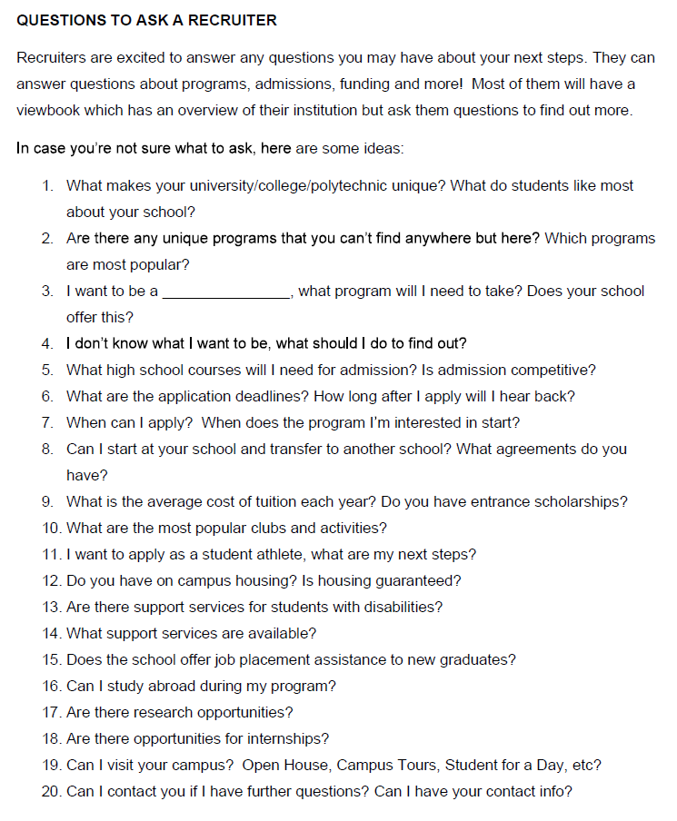

Slide 17
COMPARINGPROGRAMS​
Home or away​
Cost​
Duration​
Transferability​
Outcomes (employability, etc.)​
Class size​
Facilities​
Extra-Curricular​
Student Satisfaction data​
Guaranteed residence​

Slide 18
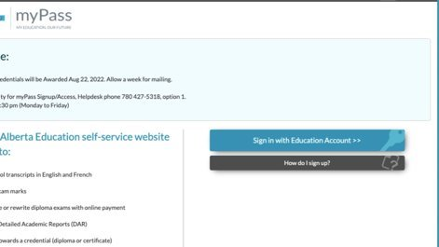
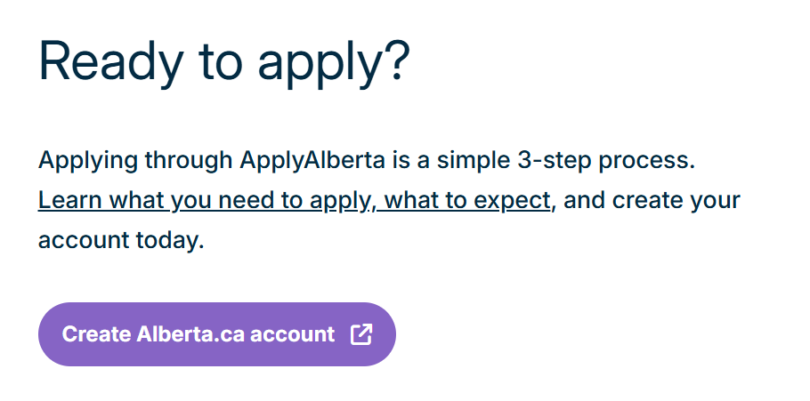
Preparing to apply
Ensure you have created accounts:
1) MyPass​
​
2) Alberta Account
Will need Alberta Student Number
​
​
​

Slide 19
Preparing to Apply
Application Portals​
Apply Alberta​
Education Planner (British Columbia)​
Ontario Universities' Application Centre​
​
--> All other provinces, students apply directly to the post-secondary school on their website​

Slide 20
Preparing to Apply​
Have copies of Detailed Academic Reports, Report Cards (obtain from MyPass, PowerSchool) ​
​
Ensure you are preparing for supplemental requirements:​
- CASPer Test for some Nursing and
Education Programs​
- Personal Profile (UBC)​
- Videos or interviews​
​
BE AWARE OF DEADLINES!​

Slide 21
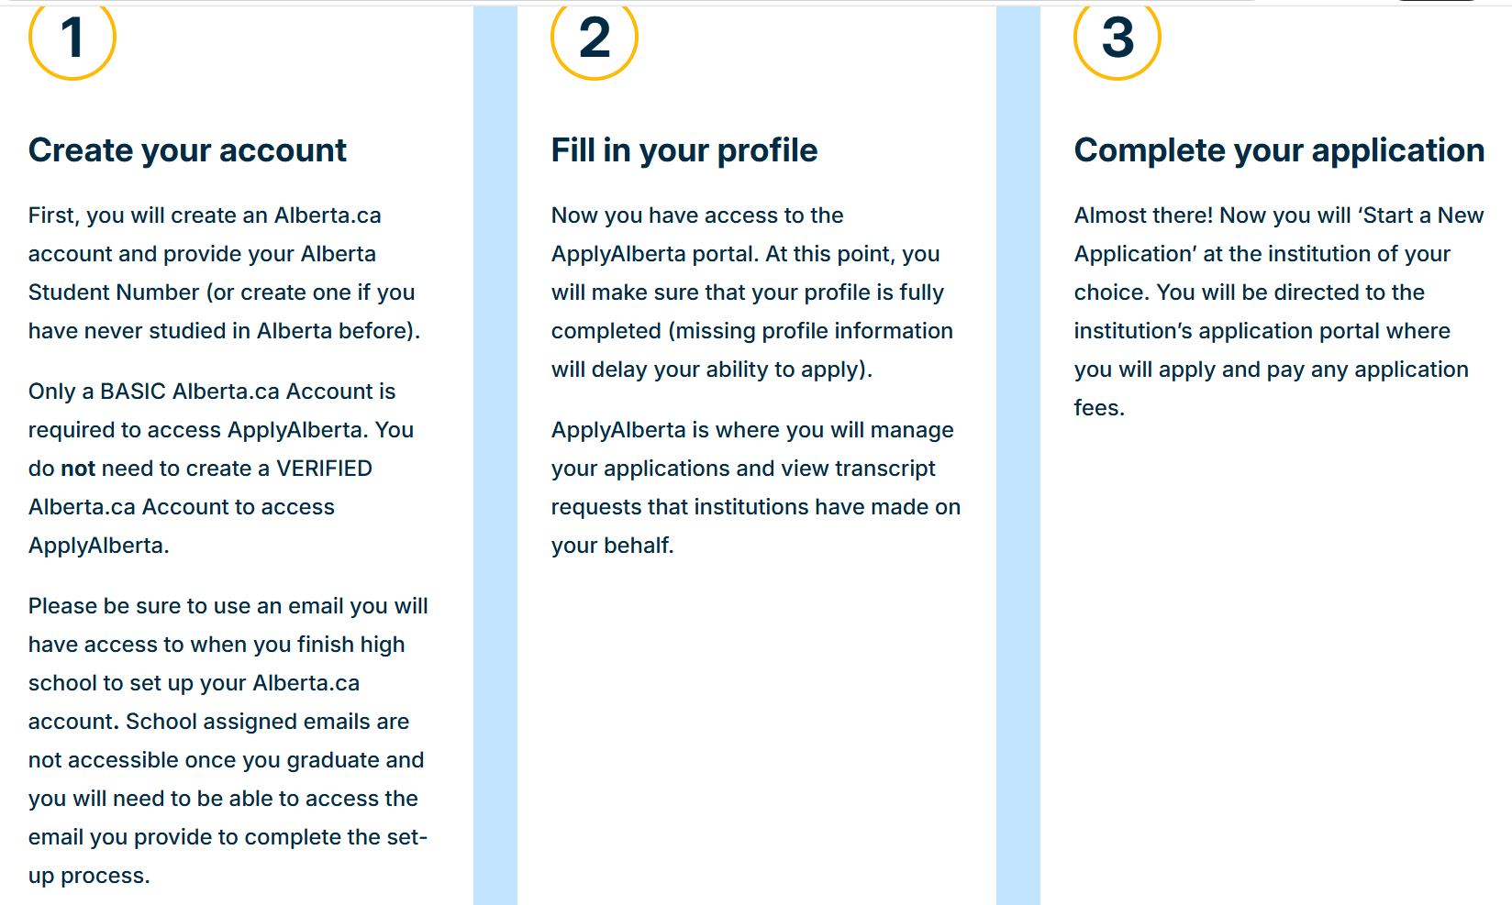

Slide 22
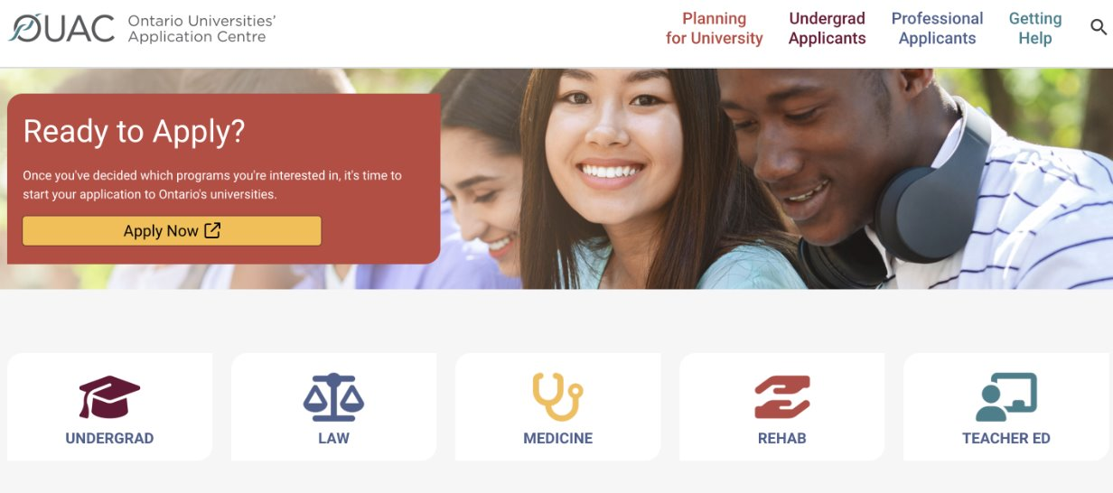

Slide 23
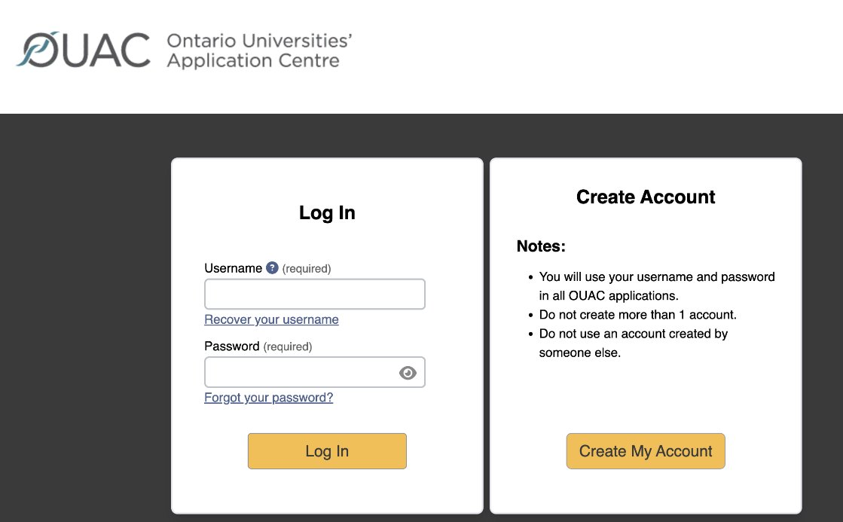

Slide 24
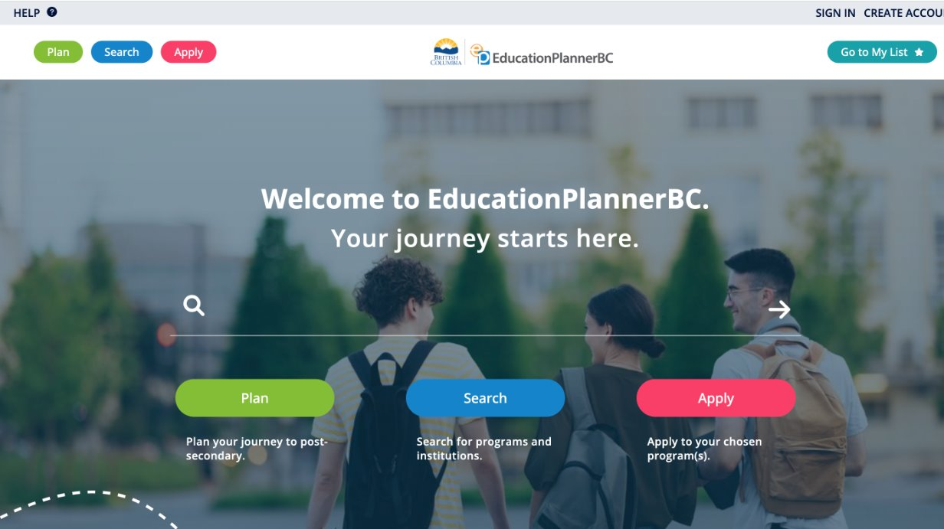

Slide 25
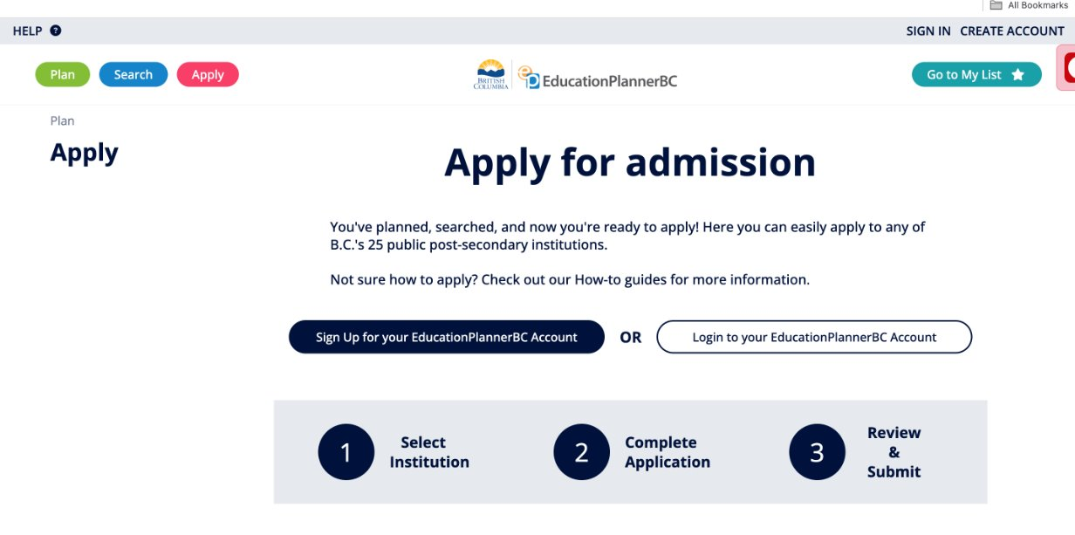

Slide 26
Applying​
Applications generally open the beginning of October. ​
Some have firm deadlines (March 1st for University of Calgary; January 15th for the University of British Columbia).​
Apply early (ex. Rolling admission policy for universities; first qualified first admit for college)​
Most post-secondary institutions allow students to select 2 program choices. ​

Slide 27
After Applying​
Check your email to ensure that receipt of application is received​
Ensure you read the email verification closely and confirm next steps​
Apply for entrance awards and scholarships​
Apply for residence, if applicable​
Mid-February- send an interim transcript (outside of Alberta)​
If offered conditional acceptance: accept offer, pay tuition deposit, and register for classes​
If attending university outside of Alberta, order final transcript to be sent via MyPass​

Slide 28
Transcripts​
Pay close attention to what the institution is asking regarding transcripts and course grade submissions as the process is not standardized. ​
U of C will require course grade submission from Apply Alberta. U of A requires course grades are inputted into their Launch Pad Portal. MRU requires students to complete a self-reported grade form and predict the final grades they will receive in grade 12.​
​
University of Calgary and other Alberta-based institutions will automatically request transcripts for students who have attended high school in Alberta. ​
​
Students who have applied to a post-secondary school outside of Alberta are required to have a MyPass account initiated to request final transcripts to be sent in July. The process for uploading an initial and interim transcript will vary by institution. ​

Slide 29
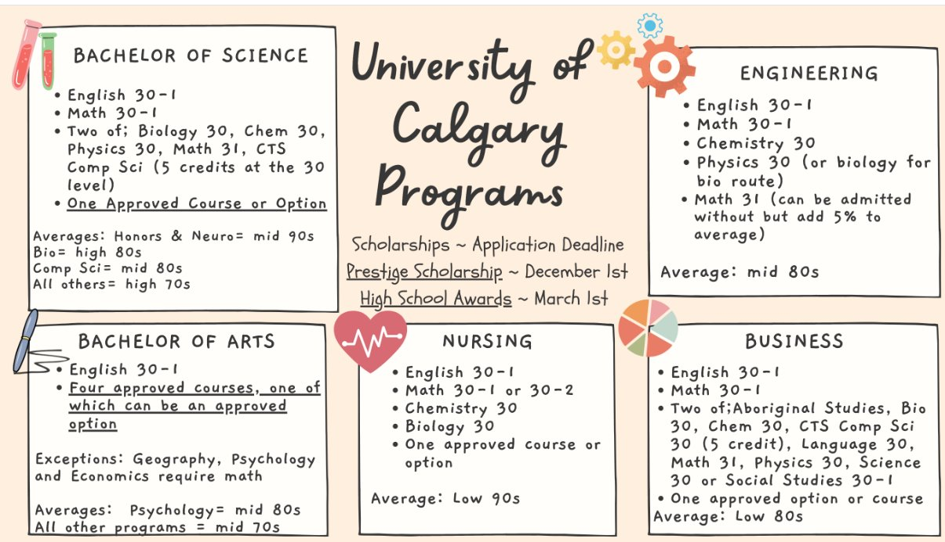

Slide 30
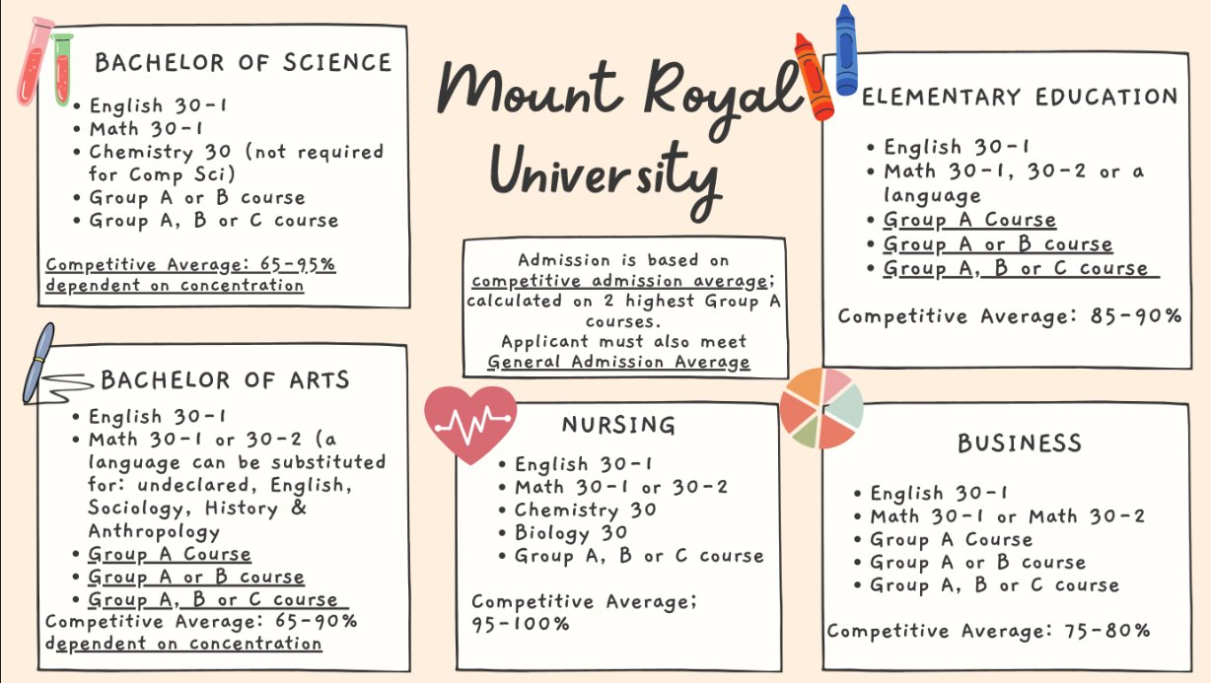

Slide 31
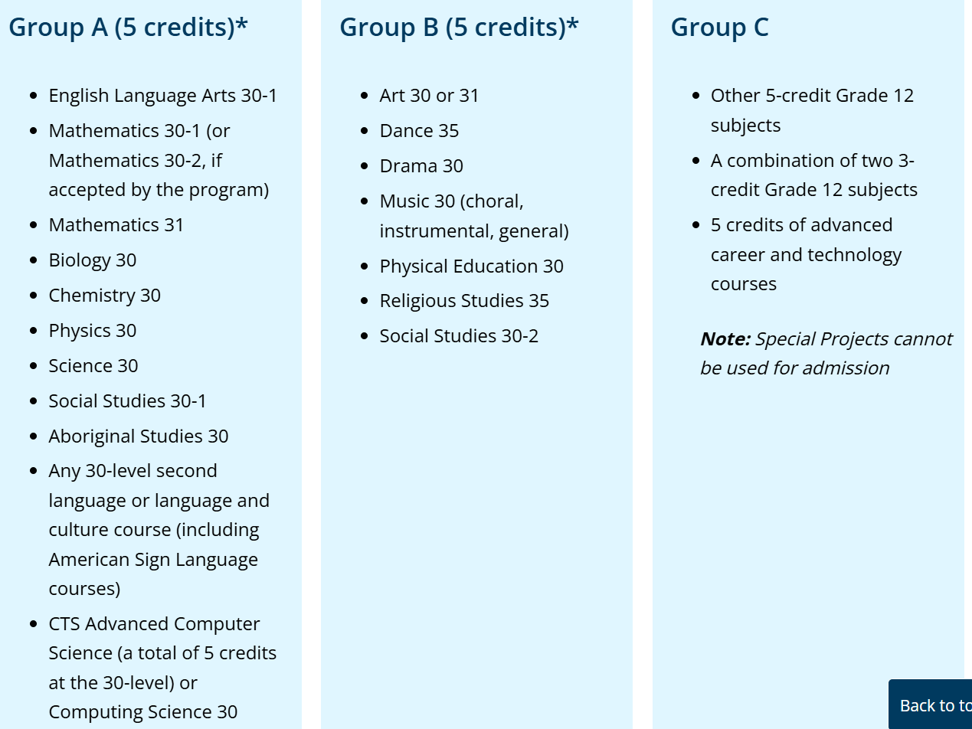

Slide 32
Alternative Routes​
Bachelor of Social Work​
Mount Royal University​
English 30-1​
Social 30-1 or Aboriginal Studies 30​
3 additional approved 30 level courses​
Social Work Diploma​
Bow Valley College​
English 30-1 or 30-2​
*Minimum grade of 65% required in English 30-2​
​
Bow Valley College Transfer Guide​

Slide 33
Applying Outside of Alberta
Ensure you meet academic requirements in grade 11 year. Many universities have different requirements: ​
UBC- Many programs require Physics 20 as an application requirement; recommended to apply with 6- 30 level courses​
University of Victoria- Apply with 4-30 level approved courses​
Familiarize yourself with approved options; out of province post-secondary schools may not recognize CTS courses but will fine arts and languages

Slide 34
LINKS​
University of Calgary​
Application Guide​
Viewbook​
Indigenous Viewbook​
Competitive Averages​
Approved Options​
Scholarships​
University of British Columbia​
Application Guide​
Viewbook​
Indigenous Viewbook​
Writing a Personal Profile​
Scholarships​
SAIT​
Application Guide​
Viewbook​
Indigenous Supports​
Admission Requirements​
Scholarships​
Mount Royal University
​
Application Guide​
Viewbook​
Programs​
Indigenous Admissions​
Competitive Averages​
Scholarships​
University of Alberta
​
Application Guide​
Viewbook​
Indigenous Guidebook​
Competitive Averages​
Scholarships​

Slide 35
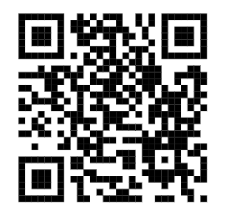
Post-Secondary Recruiter Contact Info

Slide 36

Scholarships

Slide 37
Why are Scholarships Important?
Tuition: $6000-$11 000​
Books and supplies: $1,307 to $1,717​
Mandatory fees: $611 to $1,275​
Living expenses (living with parents): $2,000 to $4,000​
Living expenses (living independently for 8 months): $9,000 to$11,200​

Slide 38
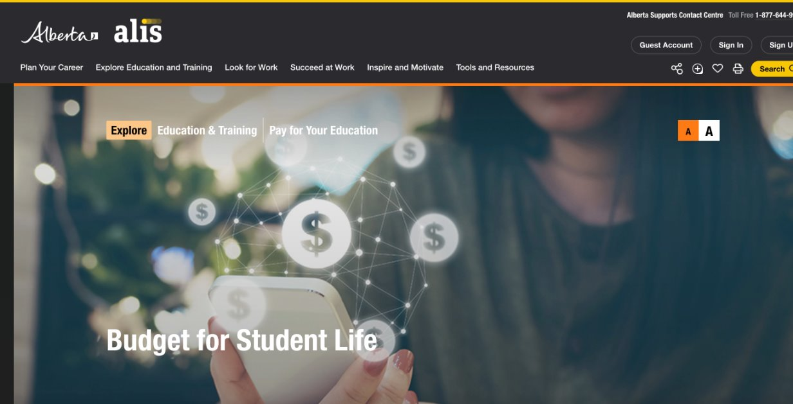
How much will school cost? ​
Get budget worksheets. Create a Spending Plan. alis.alberta.ca​

Slide 39
What Is A Scholarship?​
A scholarship is a monetary award which is often based on a variety of criteria:​
Academics​
Volunteer work/Leadership​
Extracurricular activities​
Sports​
​
Financial need may or may not be a factor.​

Slide 40
What Is A Bursary?​
A bursary is a monetary grant that is usually based on financial need.​
The student is in need of financial assistance in order to continue their education ​

Slide 41
Student Government Loans
Both the Federal and Provincial governments provide student loans for post-secondary study. Students must be Canadian citizens or permanent residents and need to apply through the province that considers them a resident. Government student loans are intended to be supplemental to student and family resources and are awarded based on financial need. ​
Apply through Student Aid Alberta​

Slide 42








Types of Scholarships​
Institution-Based Scholarships​
​
Every post-secondary institution will offer first year scholarships for first year students.​
​
Check the institution’s web page for a list of these scholarships.​

Slide 43
Institution Based Entrance Scholarships​
Open to students admitted to the post-secondary institute directly from high school.​
Students MUST apply to the institute in order to be considered.​
Students are considered based on their grade point average from high school. Often they are automatic/no separate application. *Check institution websites!​

Slide 44
2. Membership Scholarships​
Many organizations have scholarships available to members and their families. ​
Example A.T.A. (AB Teachers Association)​
​
Could include employers, clubs, cultural organizations, religious institutions, or teams. ​

Slide 45


3. CBE/Local Based Scholarships​
Managed by the Calgary Board of Education.​
Selected at school or city level.​
The typical application time for these is in the spring of the students Grade 12 year. There are a few available for grade 10 and 11 students​
--> Education Matters​
--> Calgary Foundation ​

Slide 46




4. Corporate Scholarships​
Nationally or provincially selected​
E.g. Toyota,T.D. Bank,Scotia Bank​

Slide 47
5. Government Scholarships​
Alberta: Alexander Rutherford Scholarship​
75% - 80% and higher average in 5 subjects in grade 10, 11, and 12.​
Different monetary amounts awarded depending on average.​
Value varies from $300 to $2500​
Apply in Gr 12 after being accepted​
Click here for more information ​

Slide 48
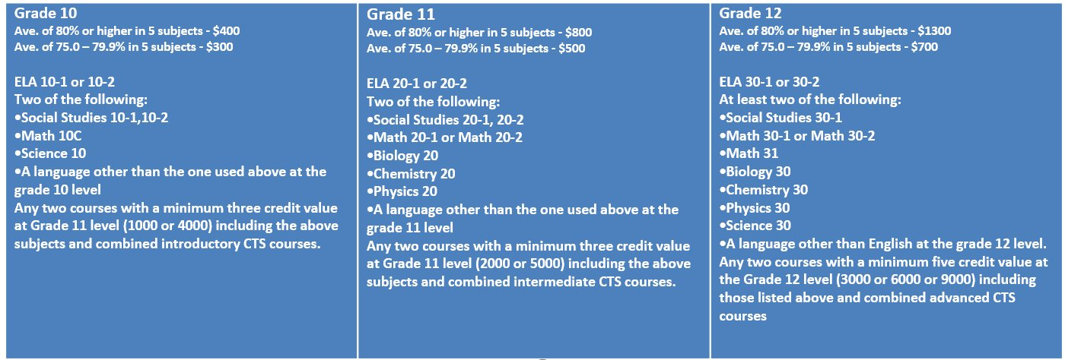
Alexander Rutherford Scholarship

Slide 49
Scholarship Profile
Create a scholarship profile on one of the following sites listed below and you will begin to receive scholarship opportunities to your email that you would be eligible to apply for​
--> Yconic​
--> Scholarships Canada​
Scholar Tree​
Others​
--> Alberta Student Aid Scholarships​

Slide 50
Any Questions?​
Optional sidebar title/text/date

